Slide 1

Eötvös Loránd University
IDEAS – ONLINE SEMINARS AT FOREIGN UNIVERSITIES

Slide 2

Structure
Eötvös Loránd University – general information
Seminar and its topics
Campus life and social interaction

Slide 3
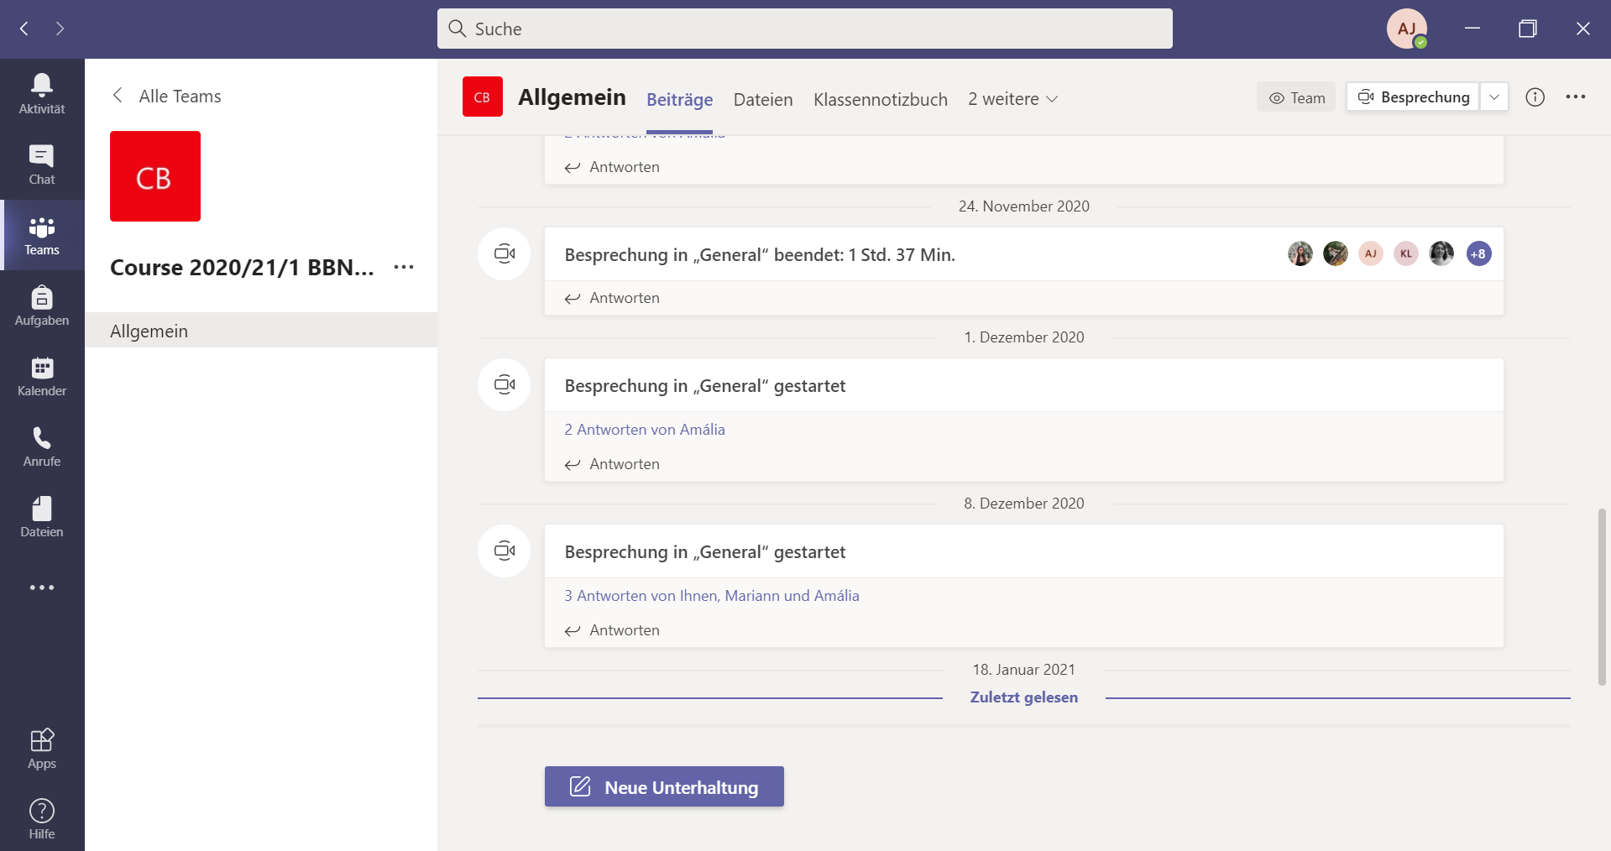
Eötvös Loránd University – general information

Slide 4
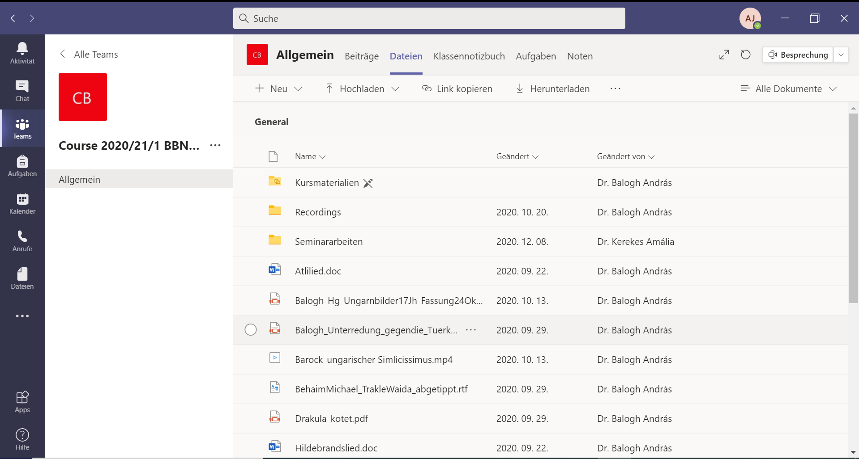
1. Eötvös Loránd University – general information

Slide 5
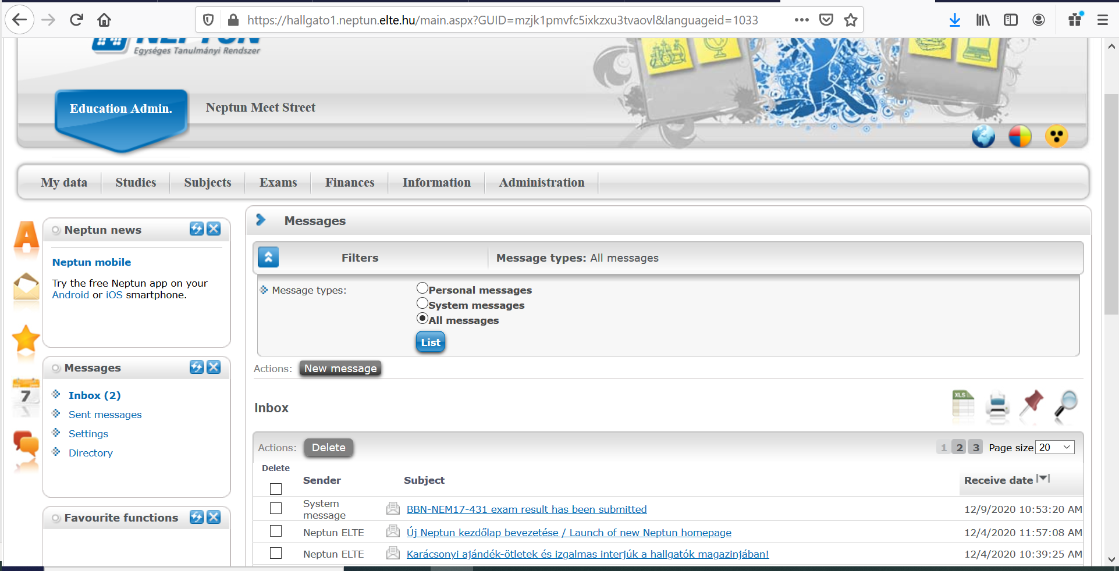
1. Eötvös Loránd University – general information

Slide 6
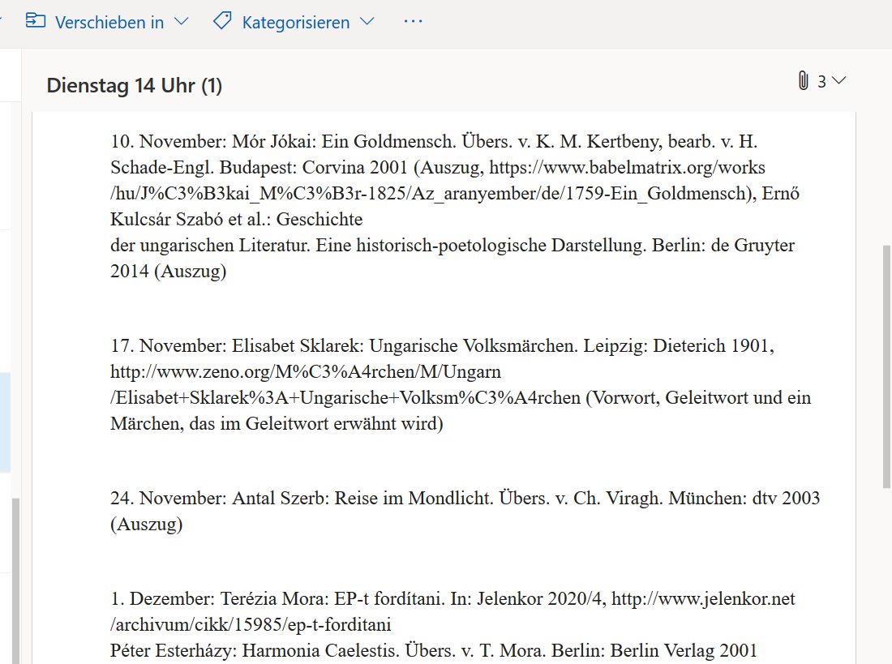
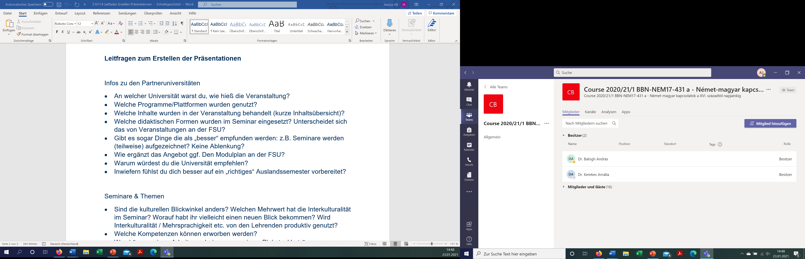
1. Eötvös Loránd University – general information

Slide 7
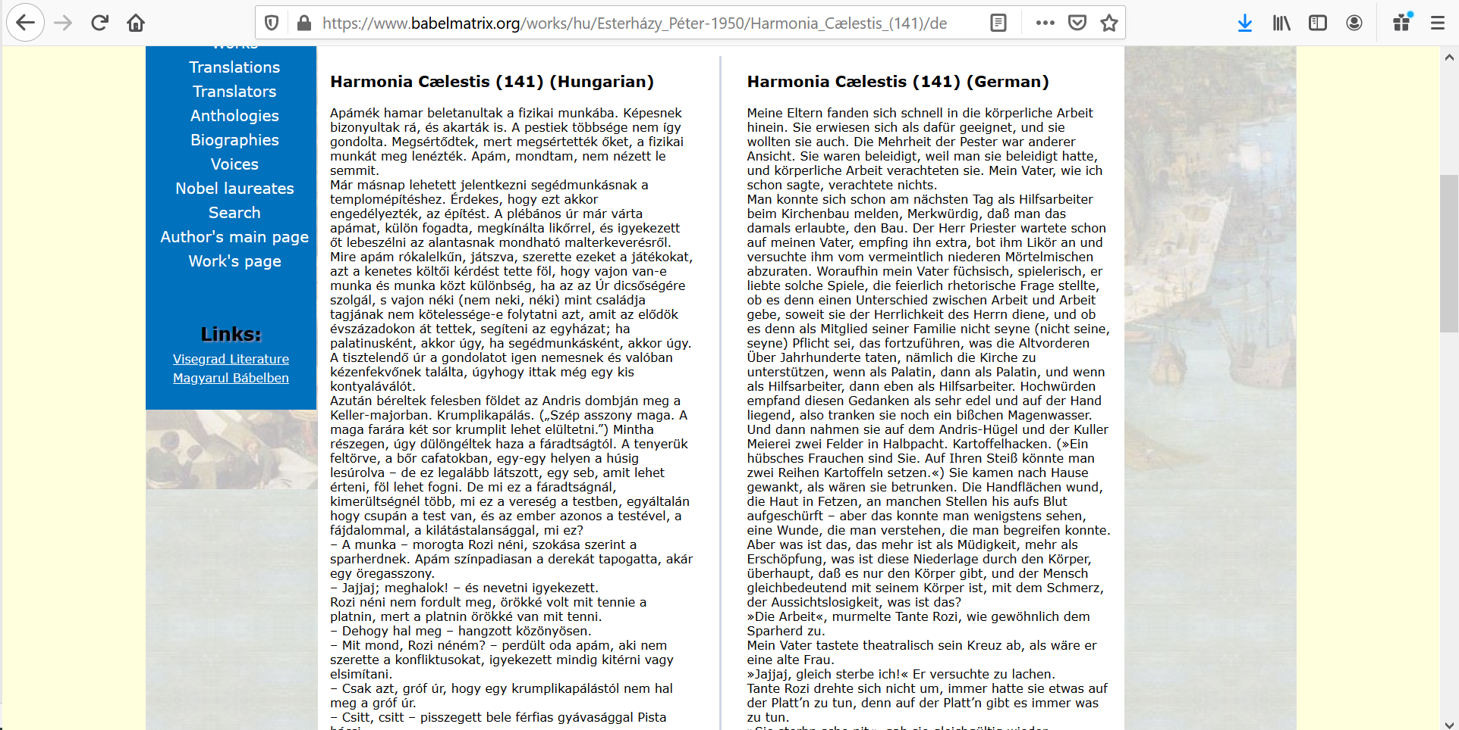
2. Seminar and its topics

Slide 8
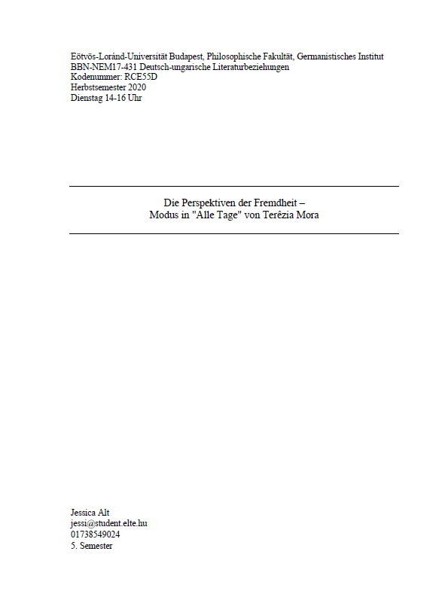

2. Seminar and its topics

Slide 9
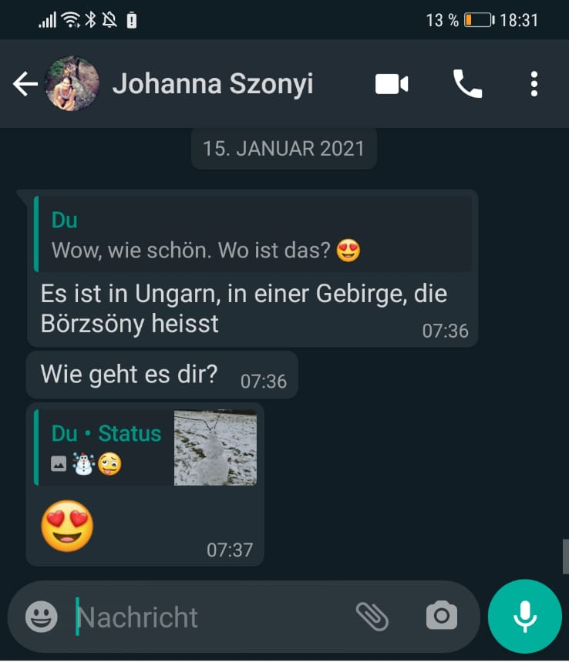
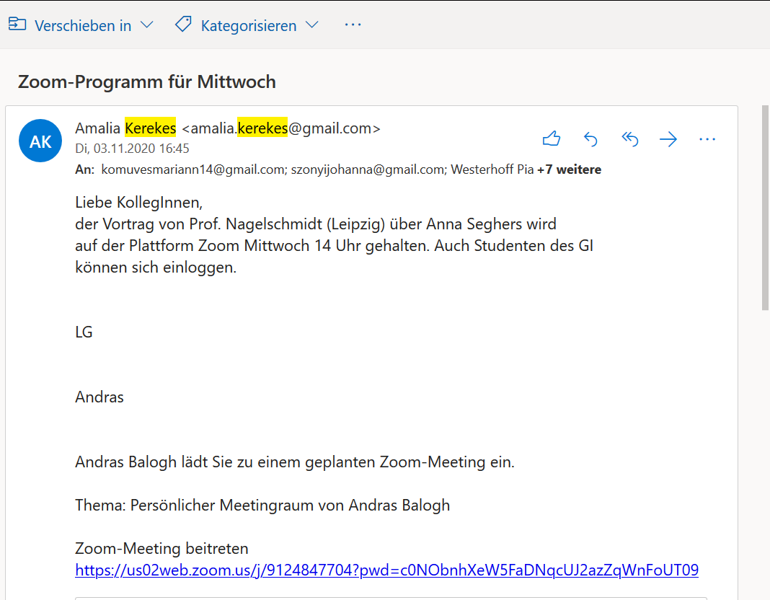
3. Campus life and social interaction

Slide 10
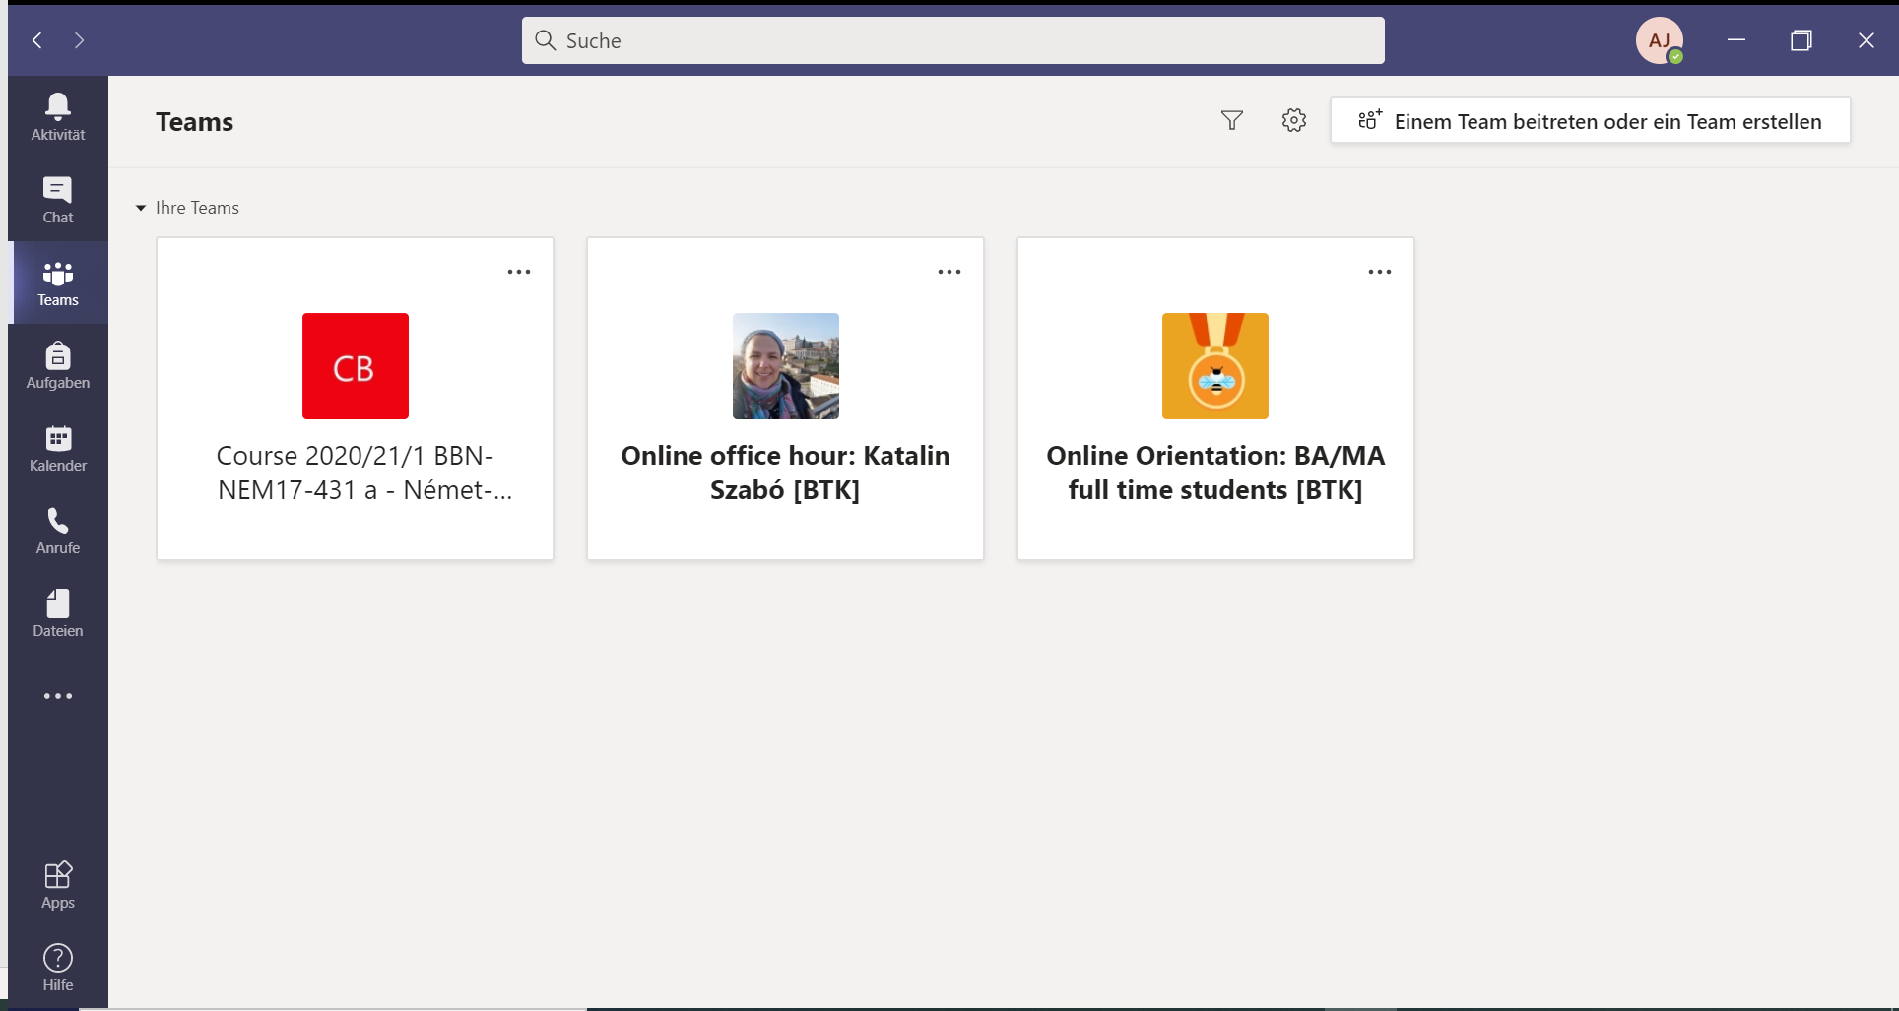
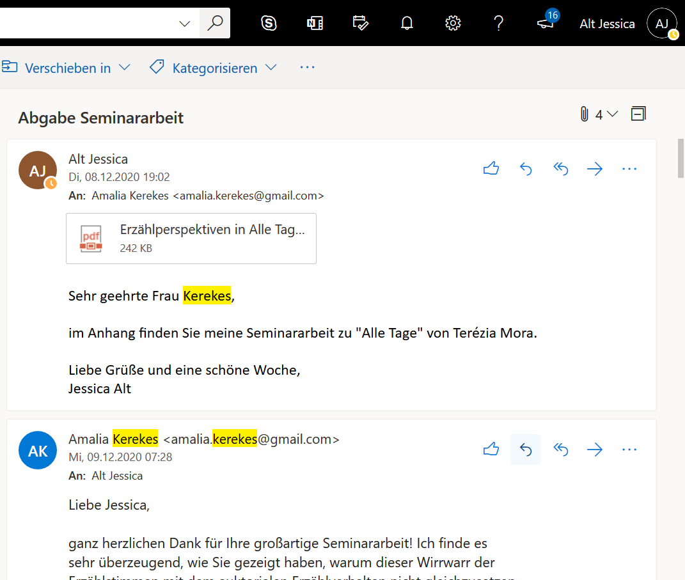
3. Campus life and social interaction

Slide 11

Eötvös Loránd University – Campus Life and social interaction

Slide 12
Sources
https://www.zlb.uni-jena.de/internationales/lehramt_international_+ideas (access 23/01/2021)
https://de.wikipedia.org/wiki/E%C3%B6tv%C3%B6s-Lor%C3%A1nd-Universit%C3%A4t (access 23/01/2021)

