Slide 1

IDEAS – Pilotprojekt Onlineseminare an ausländischen Universitäten
Annemarie Crivellaro, Natalie Wettges, Sophie Fischer, Michelle Dannemann

Slide 2



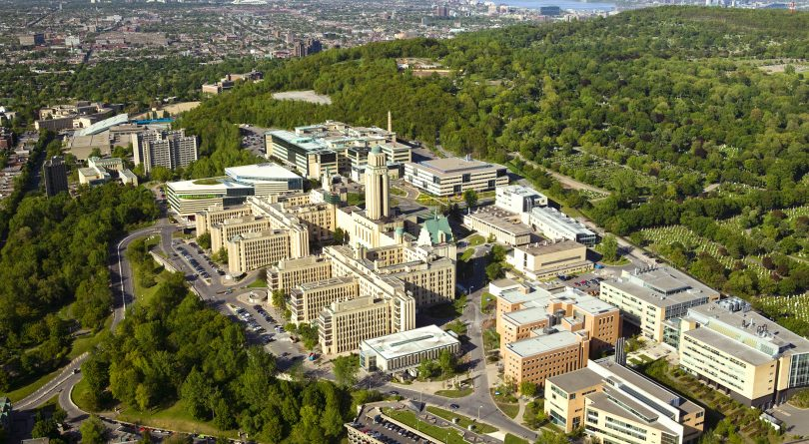
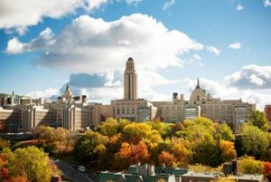
Université de Montréal, Canada
department d‘études anglaises
ANG 2362 Literature and Globalization
Globalization, Pandemics and Literature
fall 2020

Slide 3


StudiUM / Zoom
weekly meetings: Thursdays 7 - 10 pm on Zoom
homework, assignments and organization on StudiUM

Slide 4
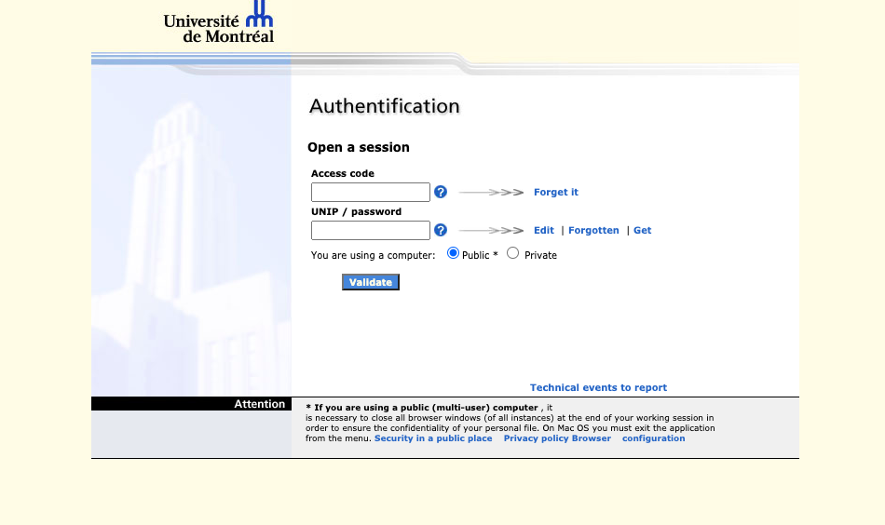

Slide 5
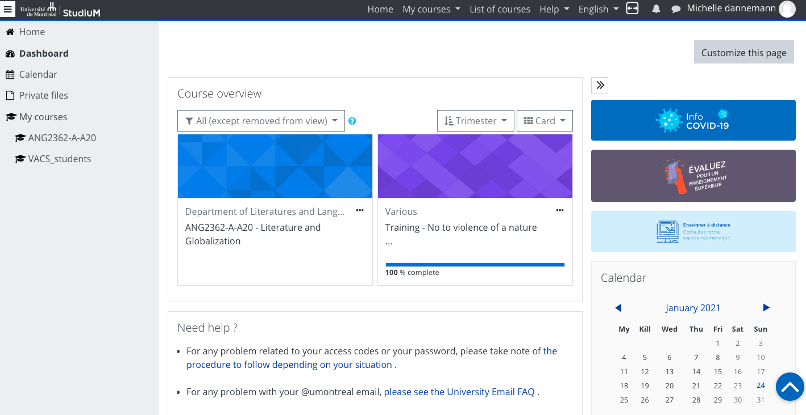

Slide 6
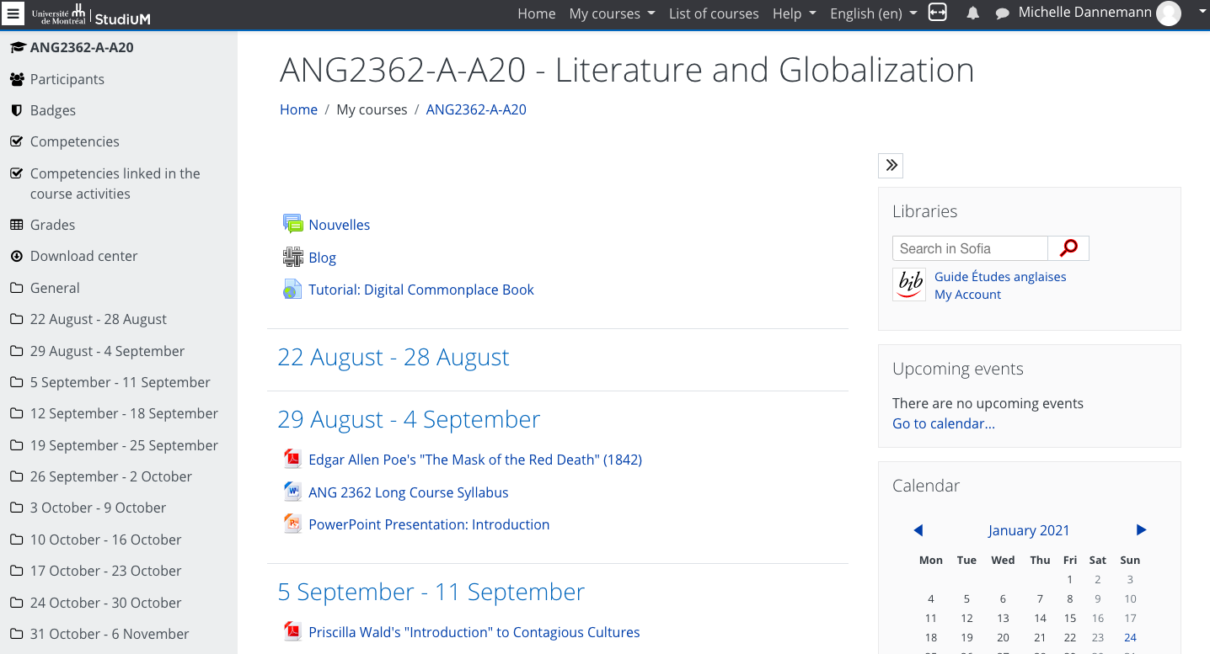

Slide 7






Course Syllabus
fictional literature, secondary literature
affects, languages and ideologies of pandemics
disease, empire and globalization
the global risk society
reproduction, race and pandemics
pandemics, literature and climate change
unthinking the pandemic – rethinking the planet
-> continuous references to the presence (Covid-19)

Slide 8
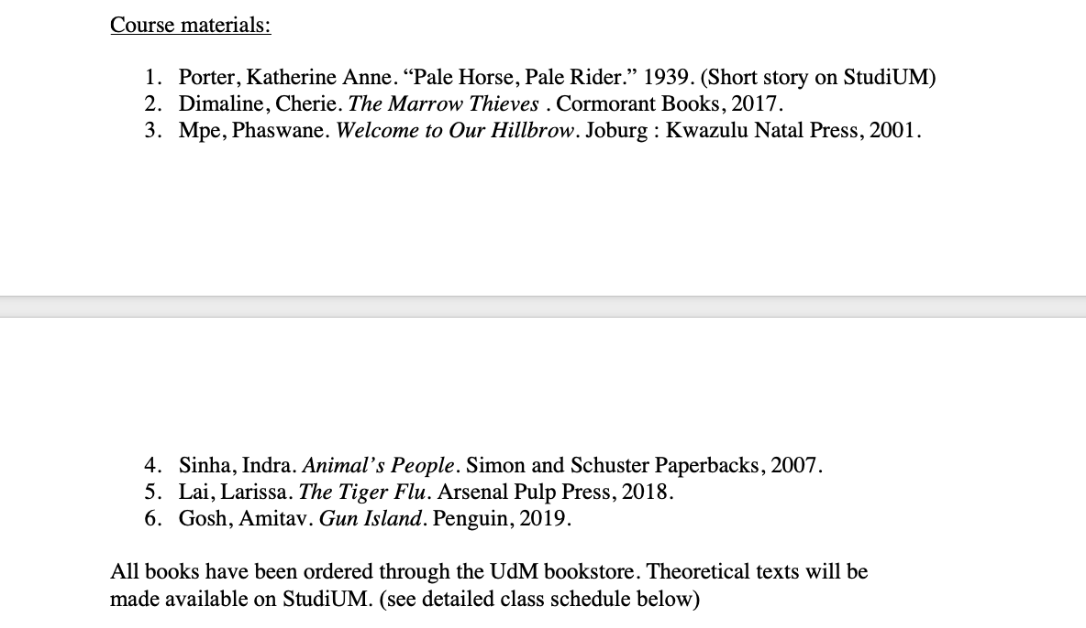

Slide 9
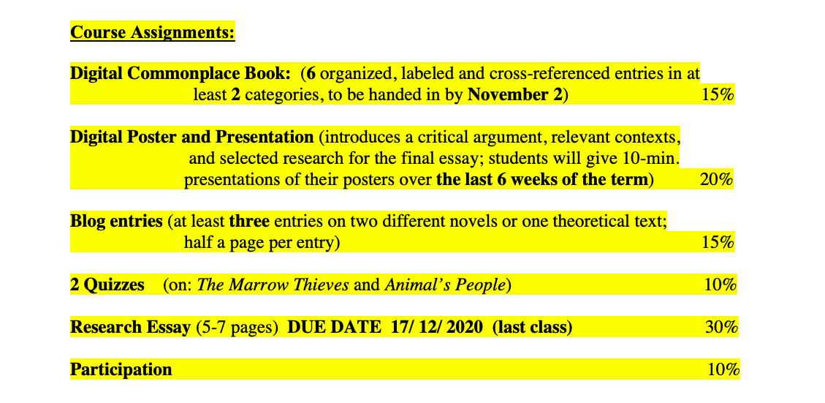

Slide 10
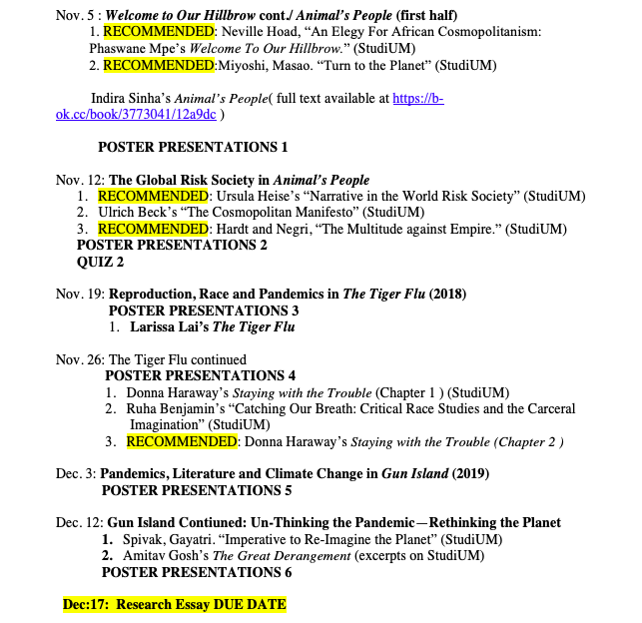

Slide 11
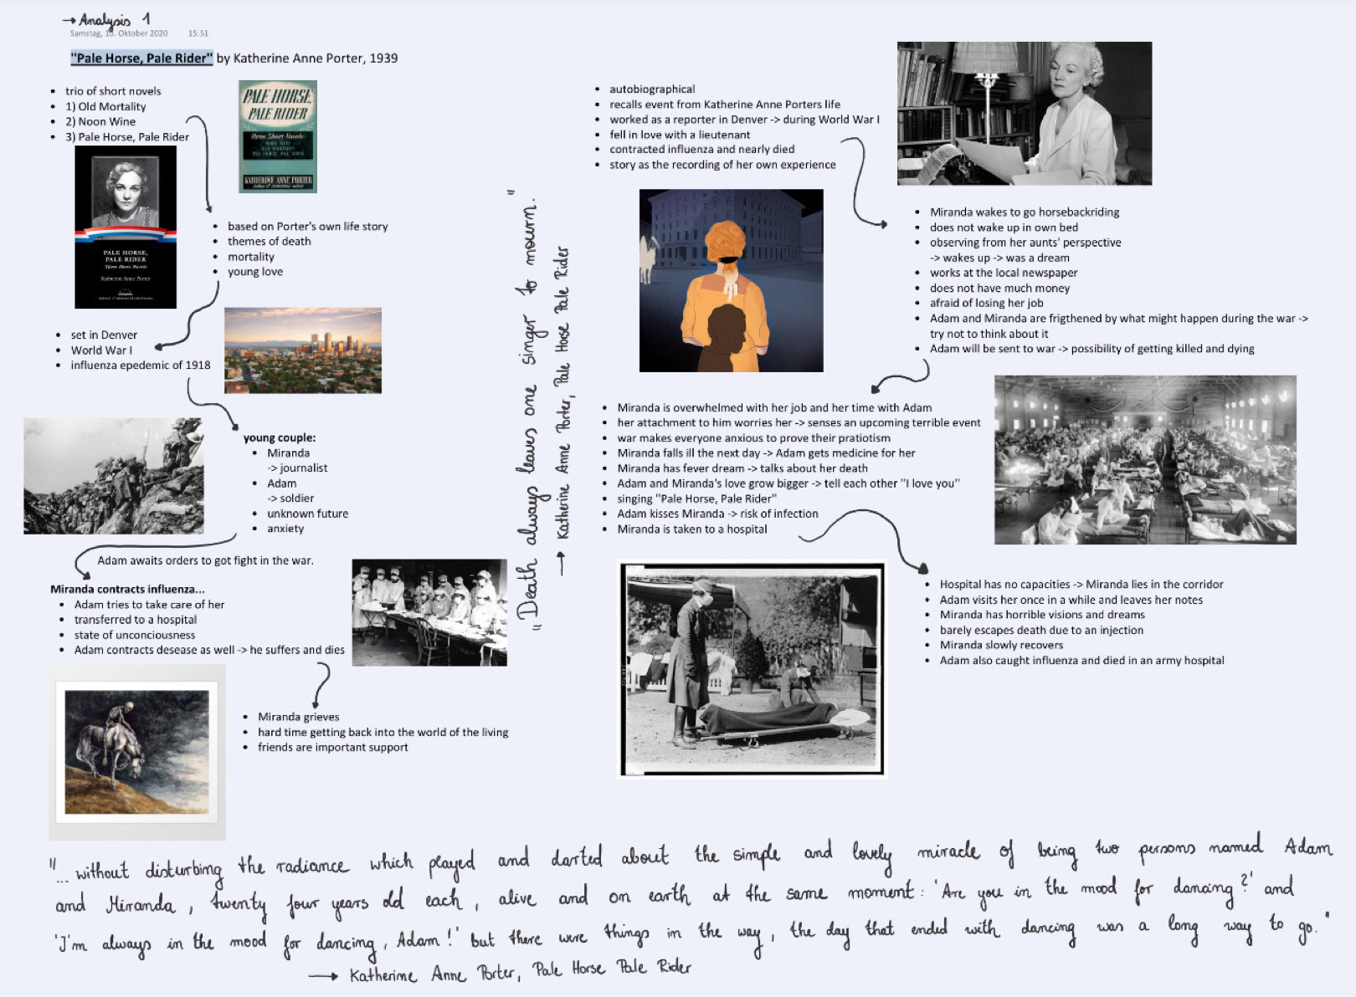
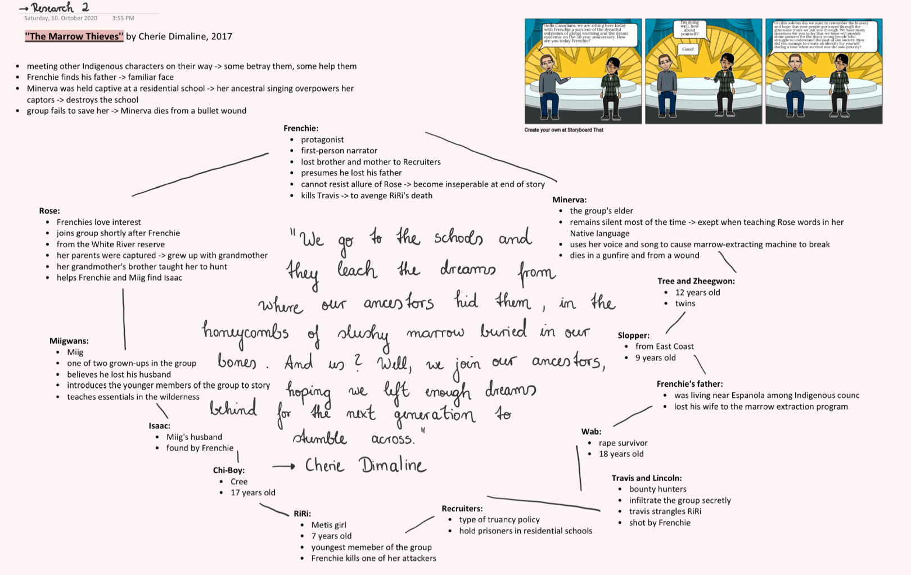
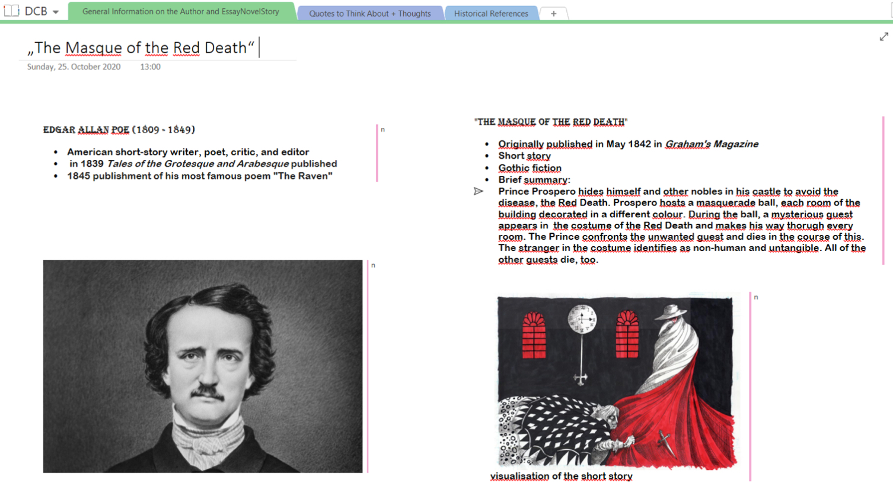
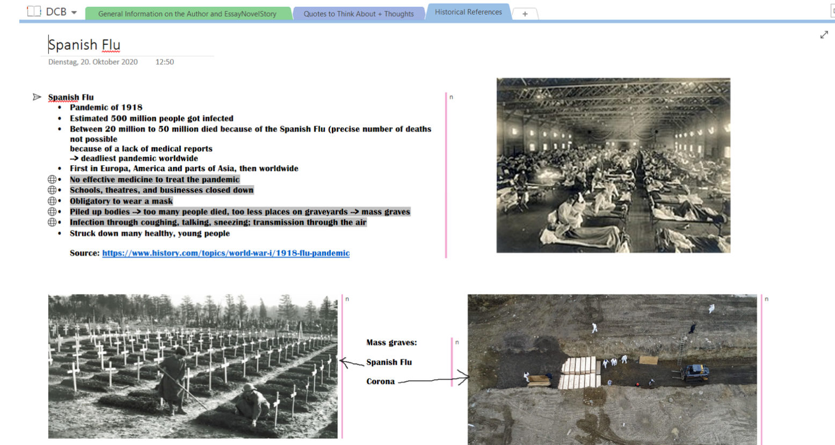
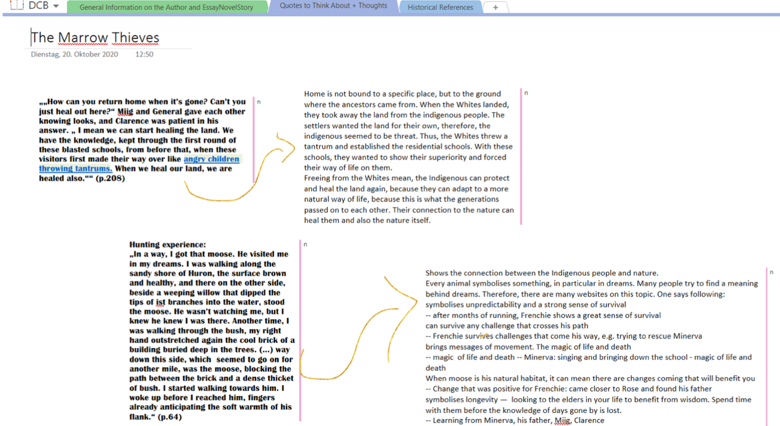
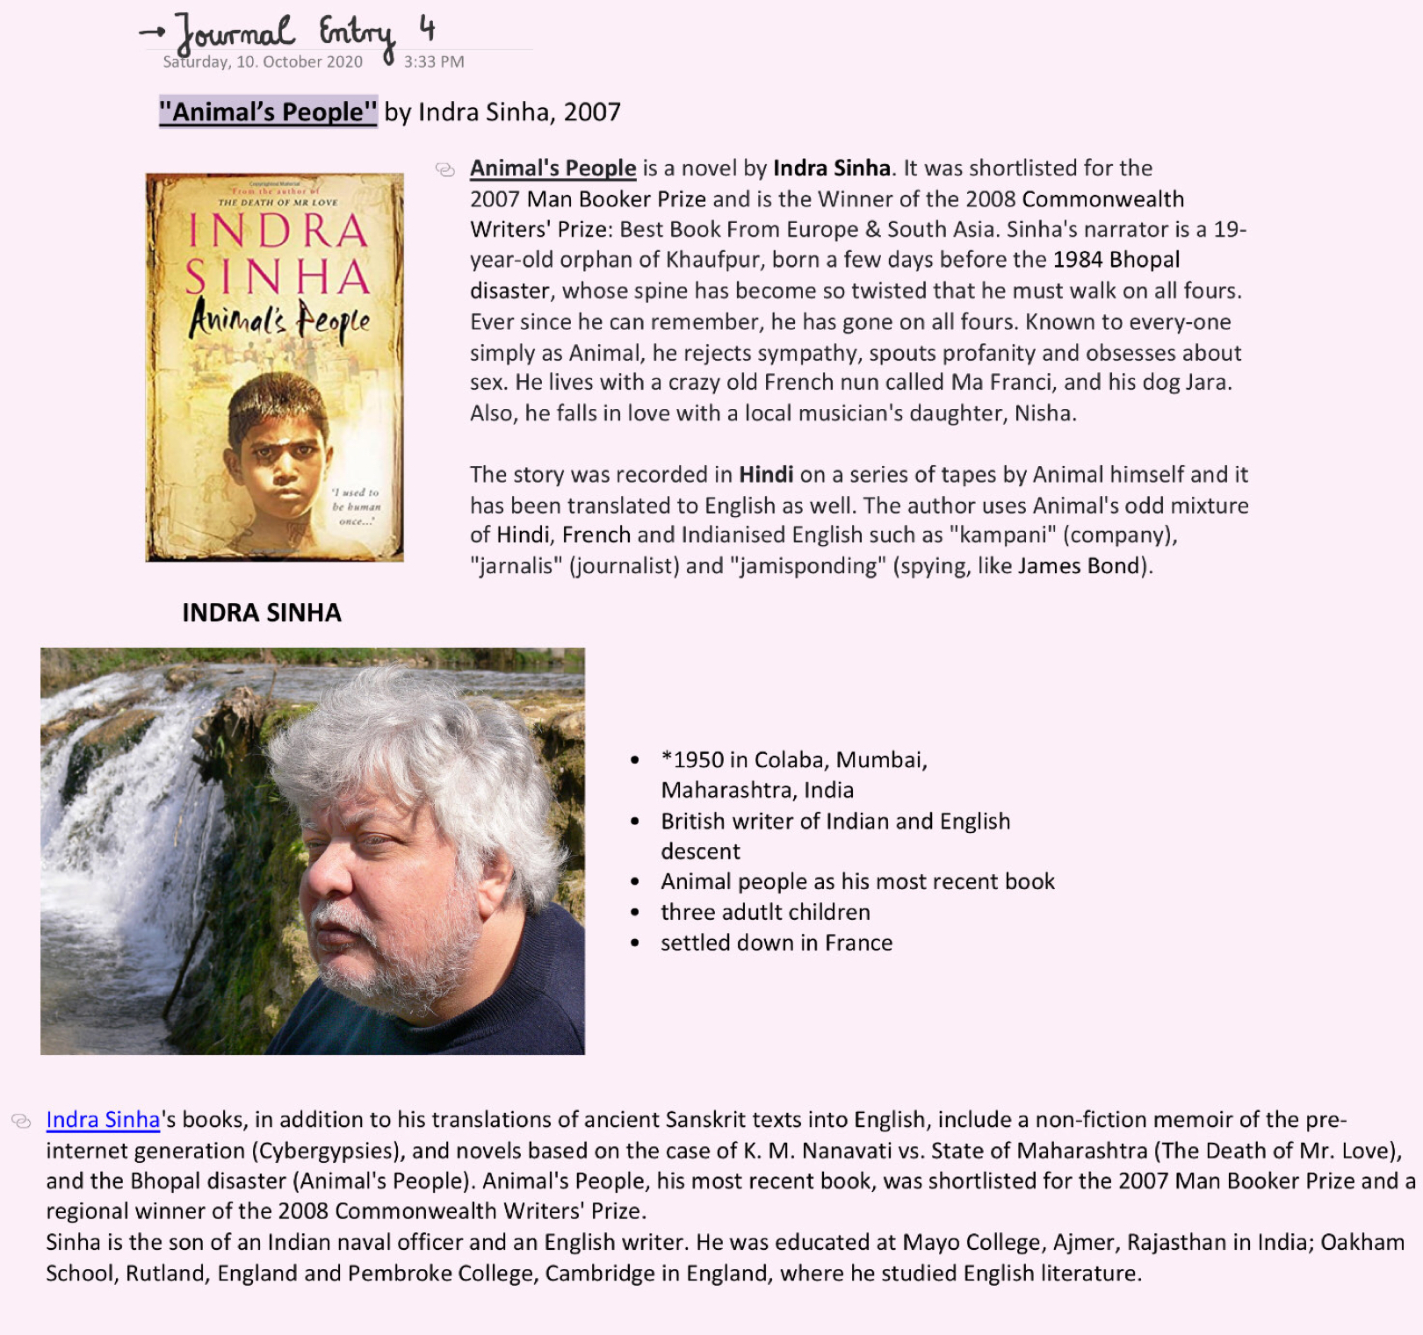
DCB – digital commonplace book

Slide 12
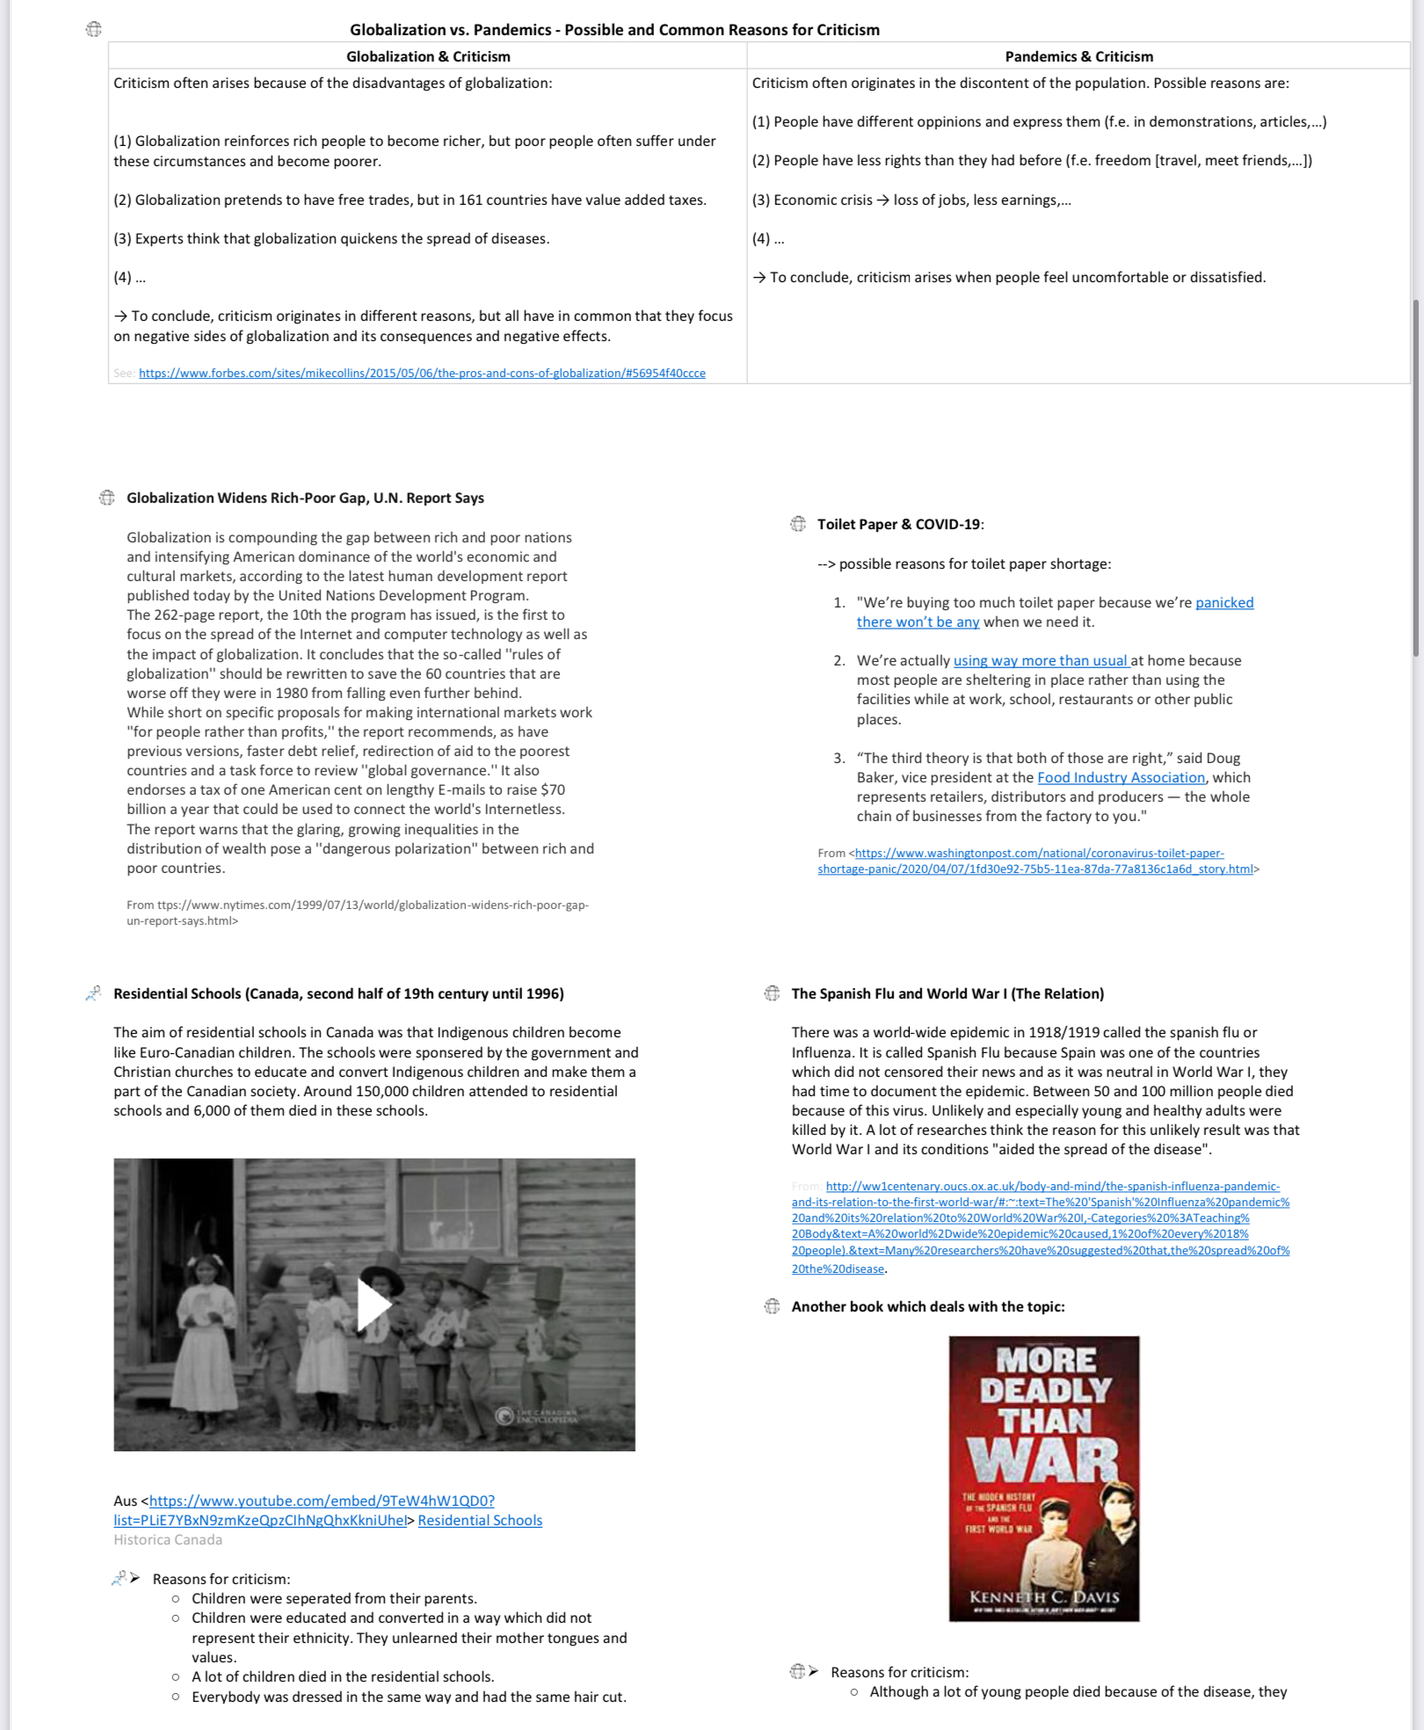
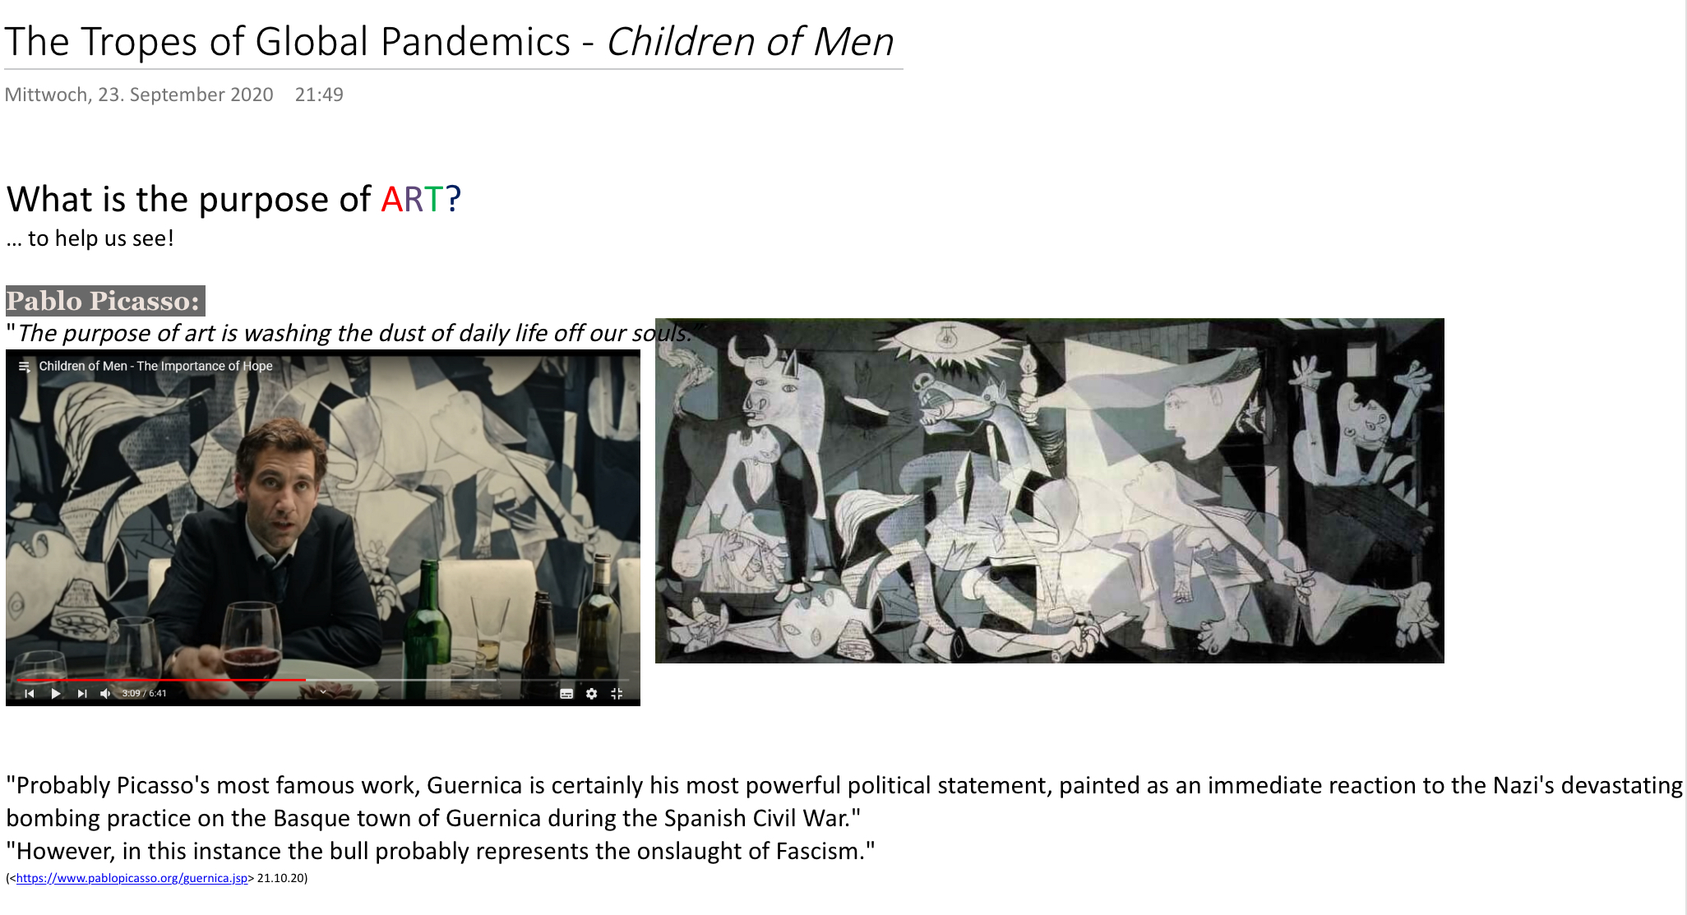
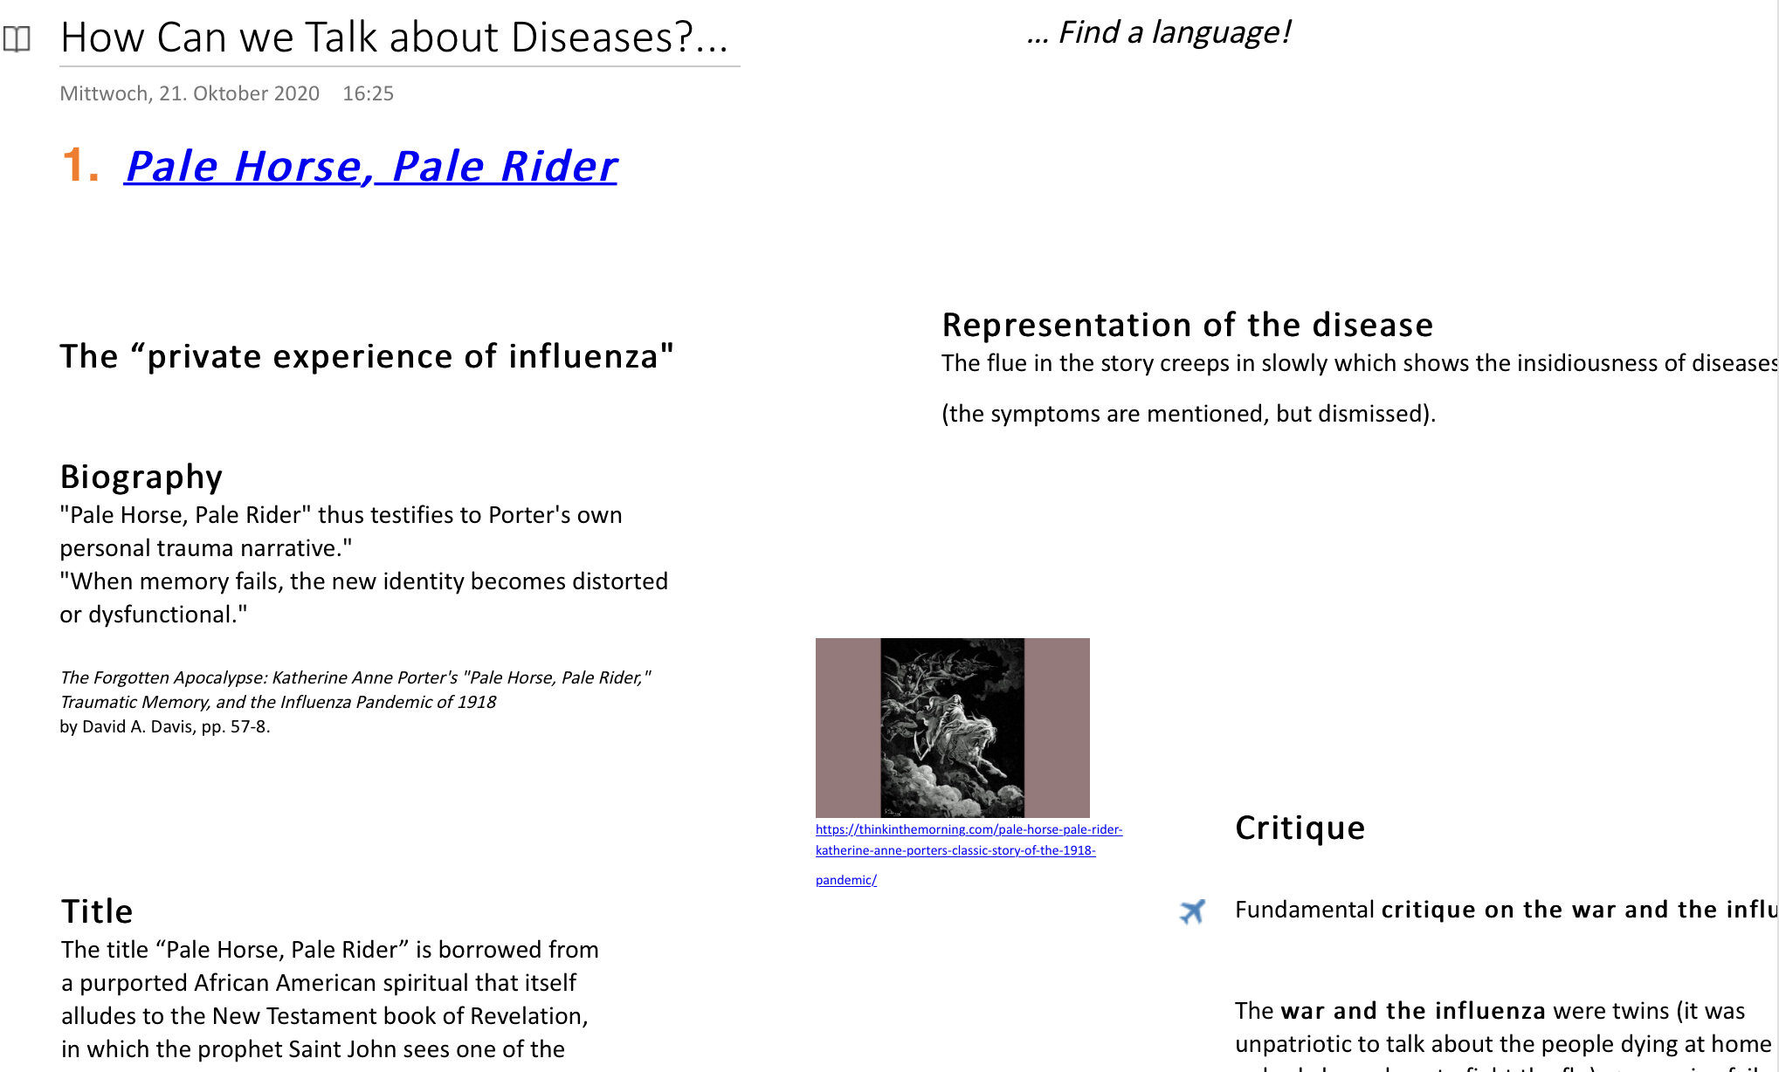
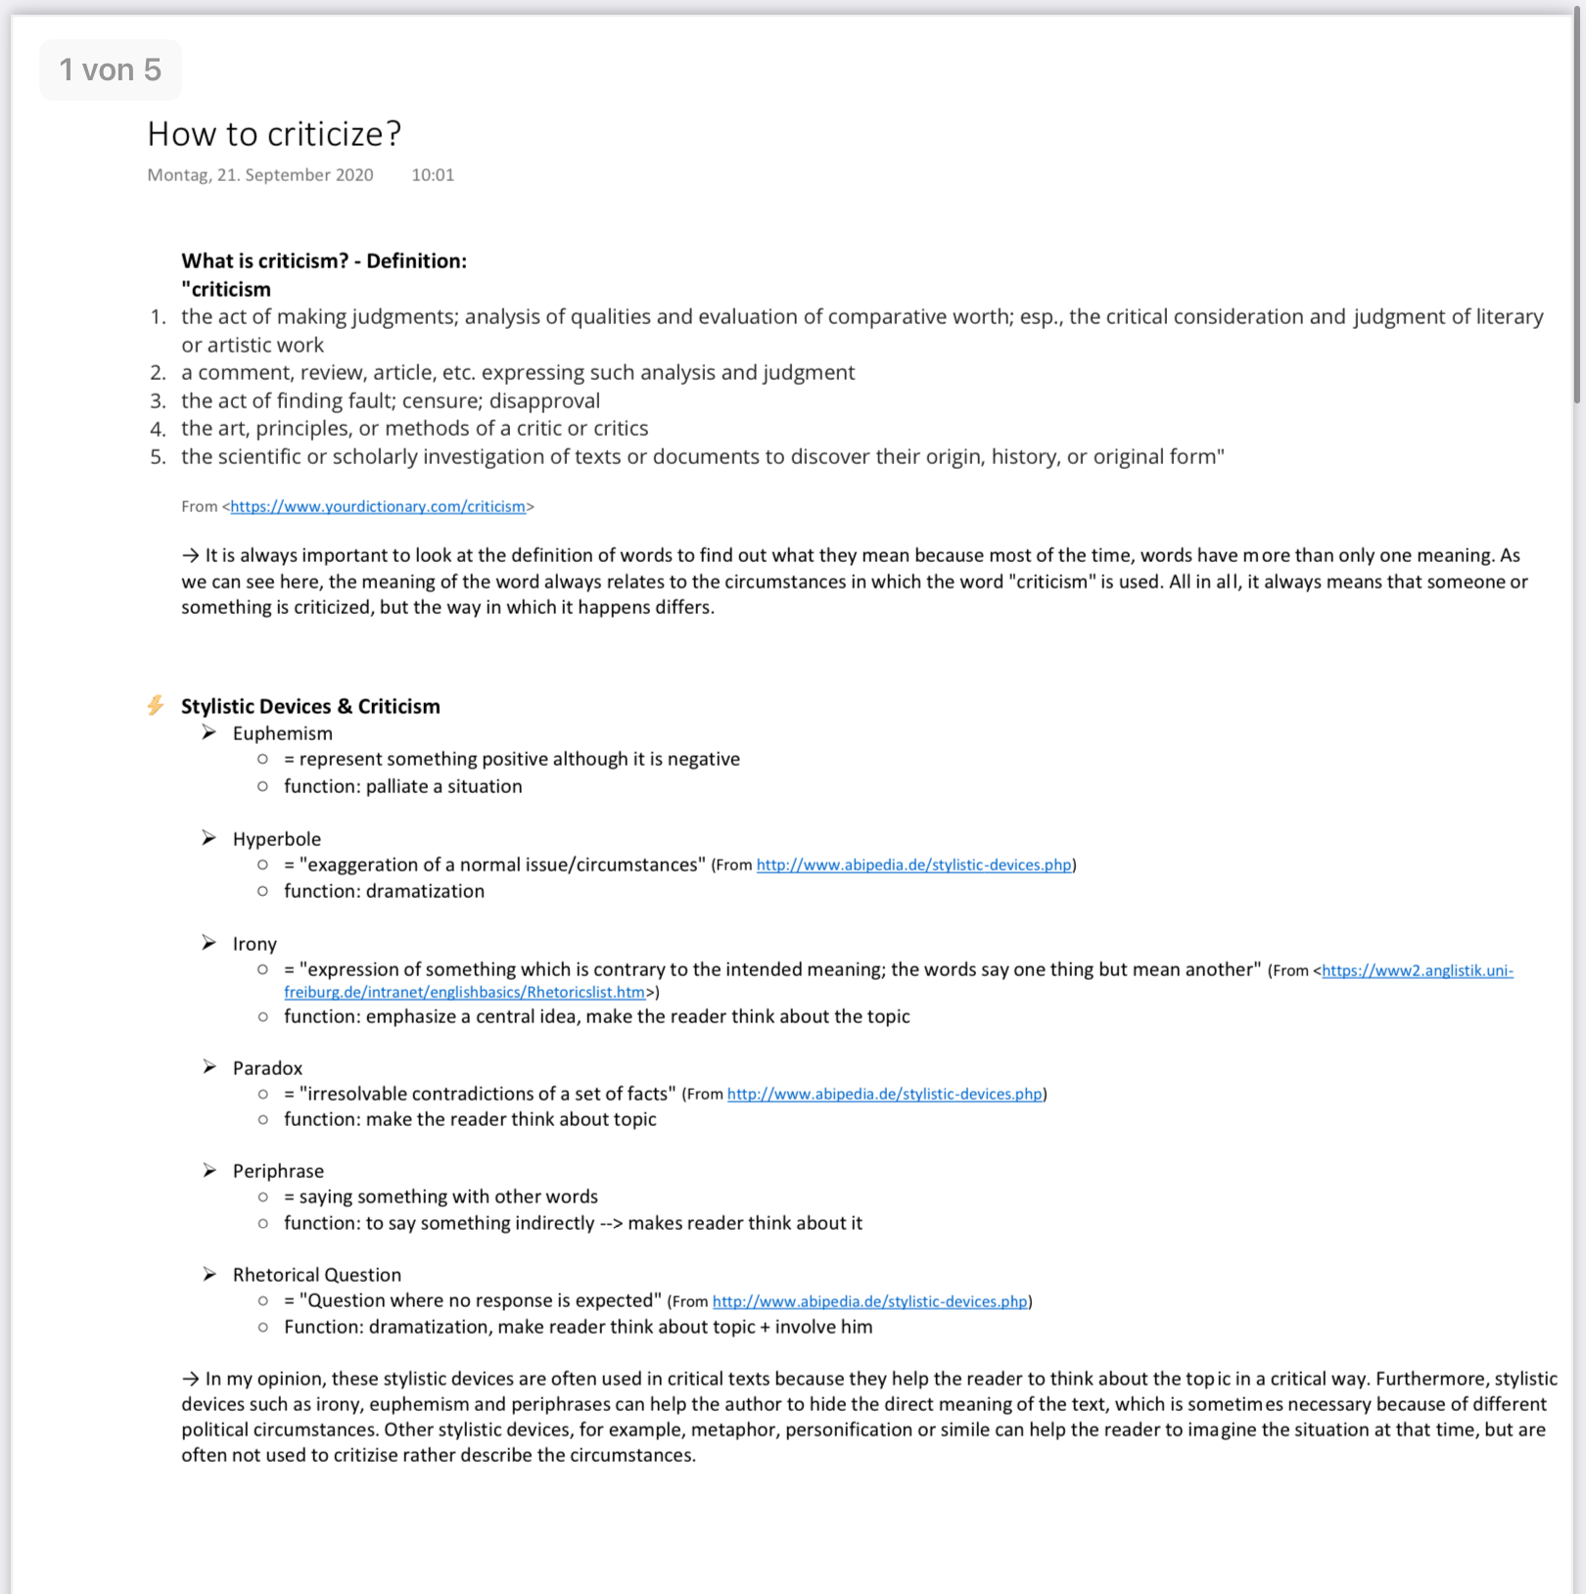
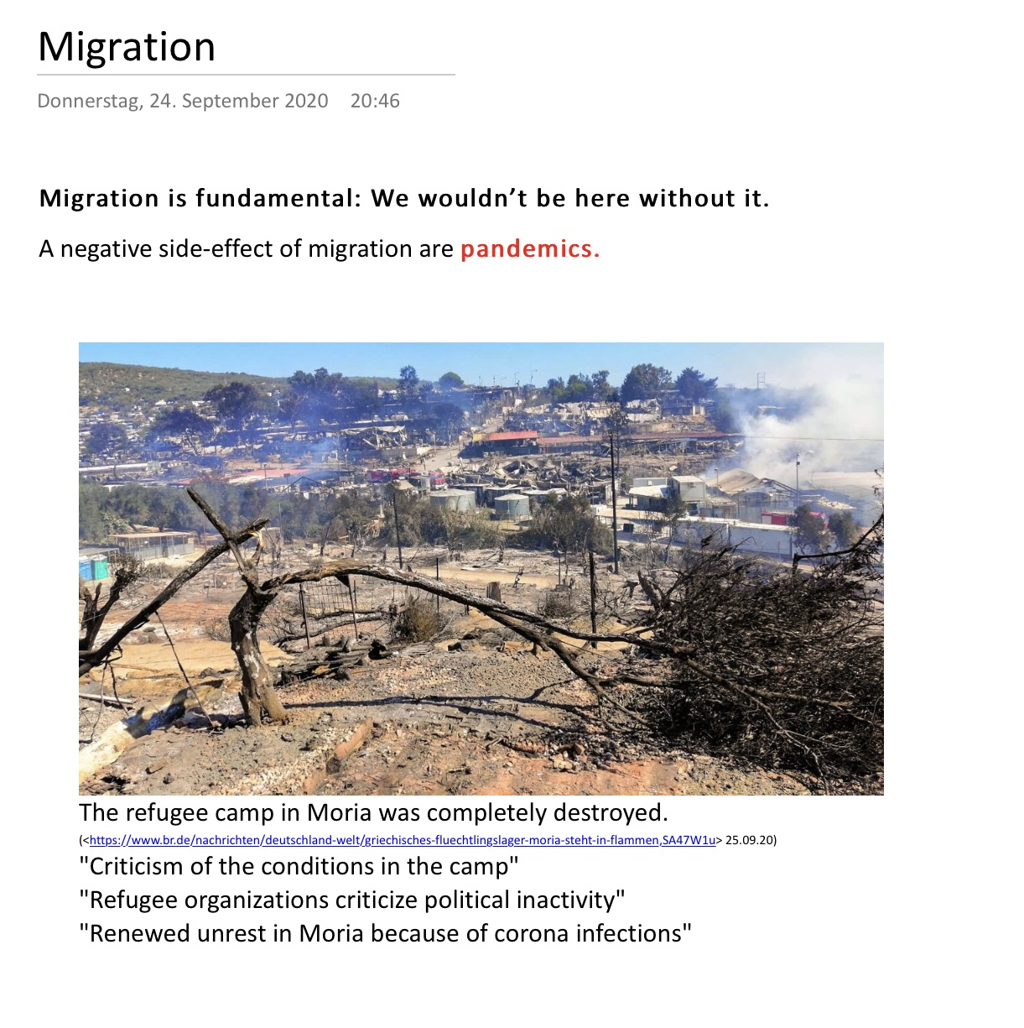
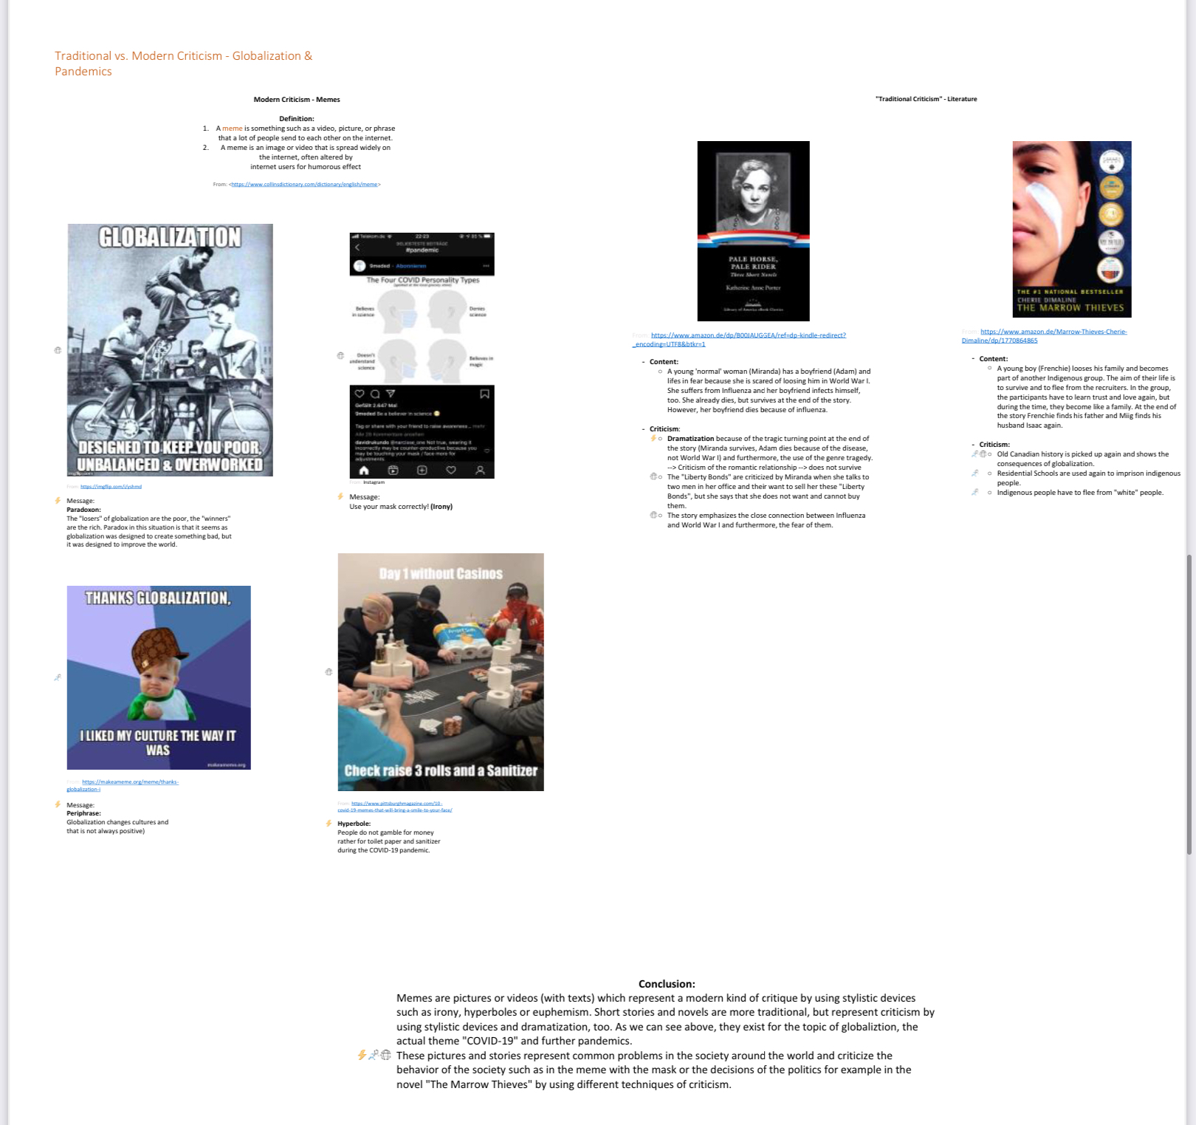

Slide 13
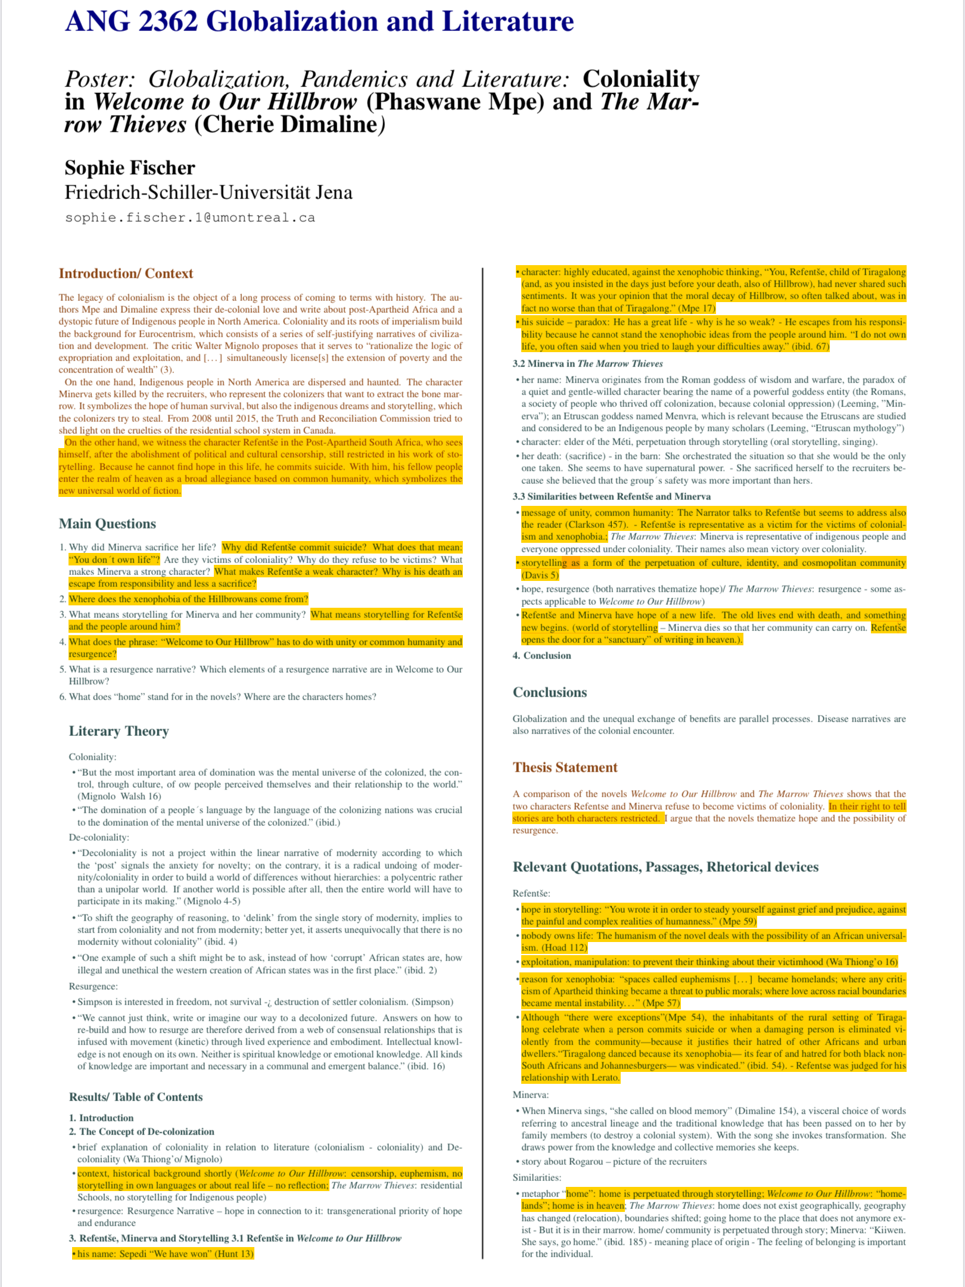
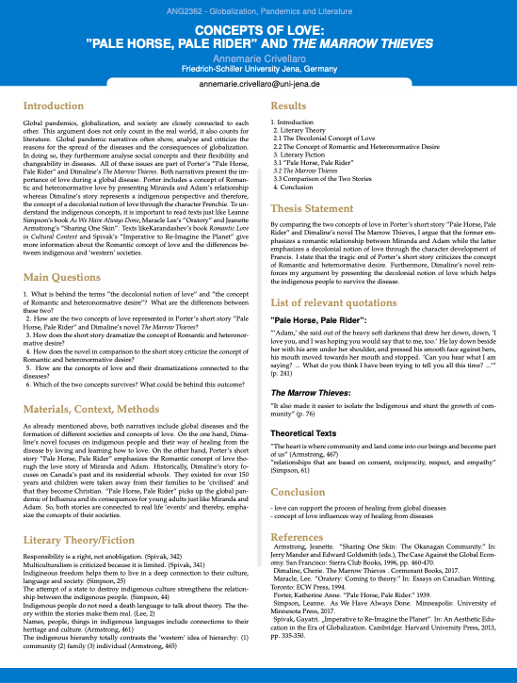
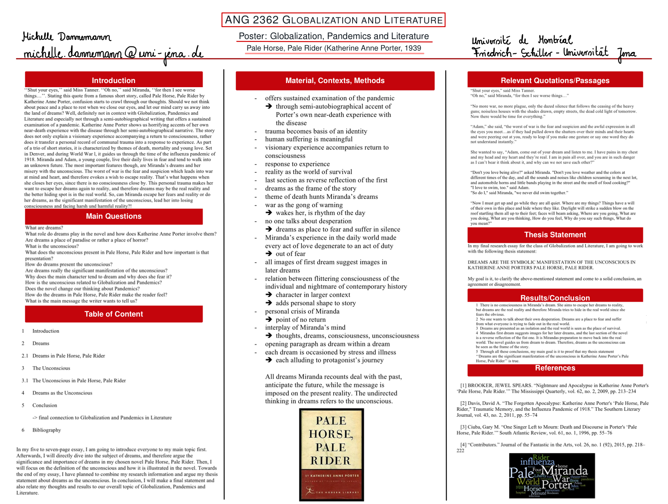
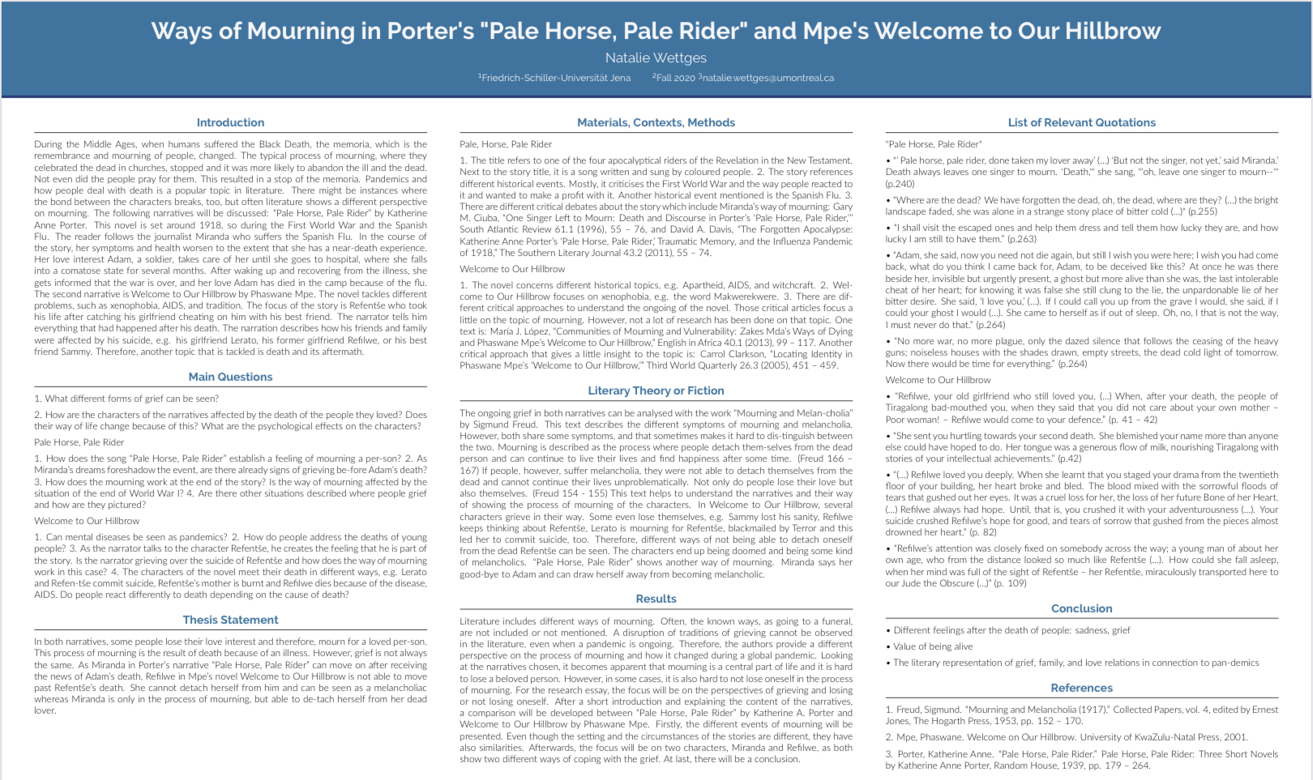
Digital Posters

Slide 14
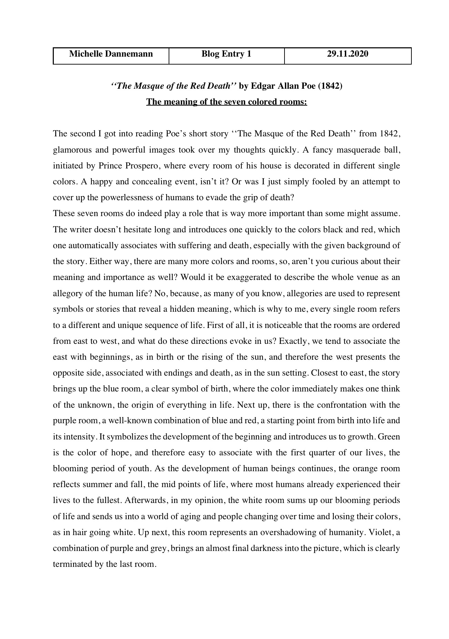
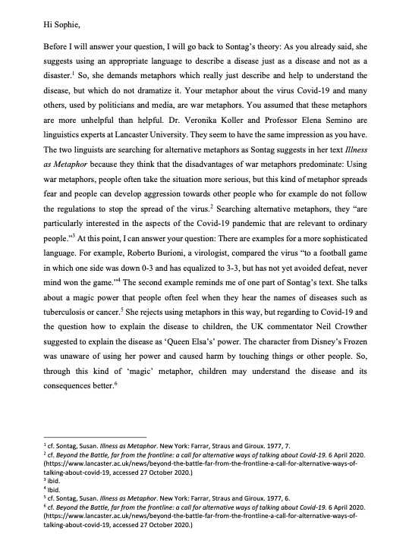
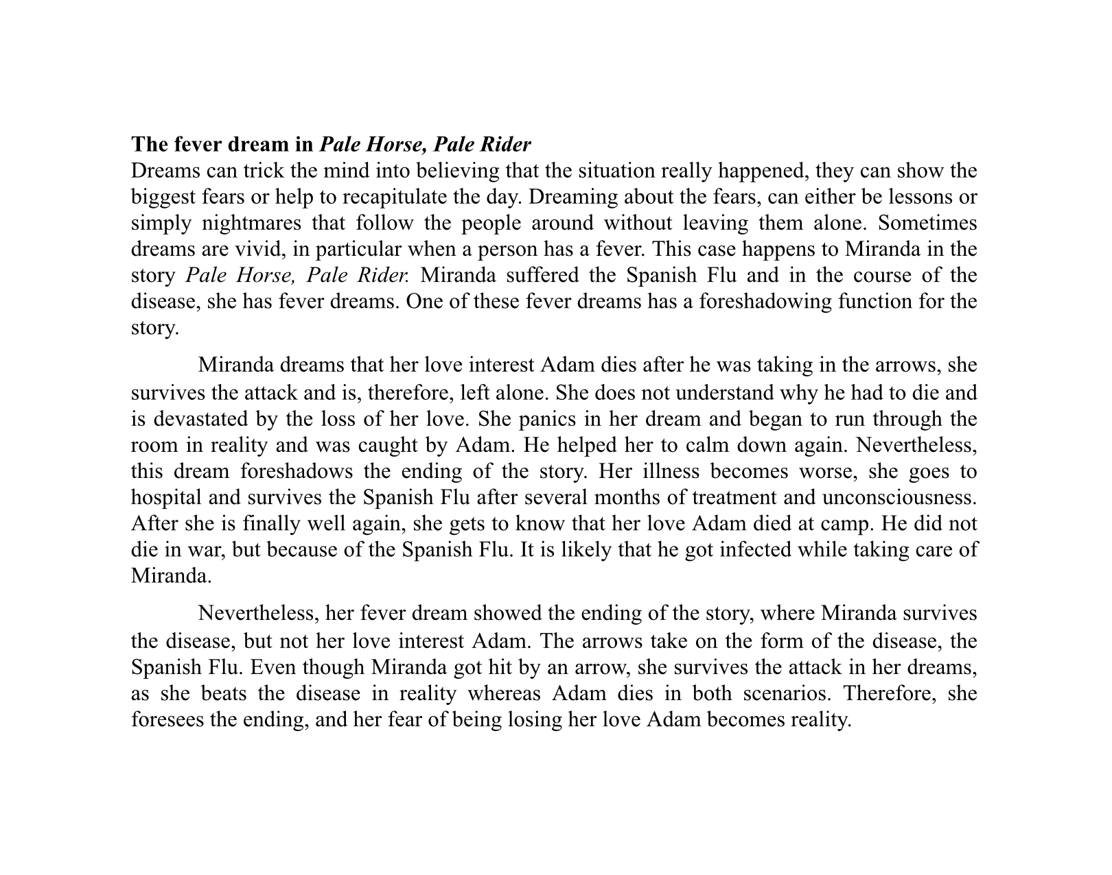
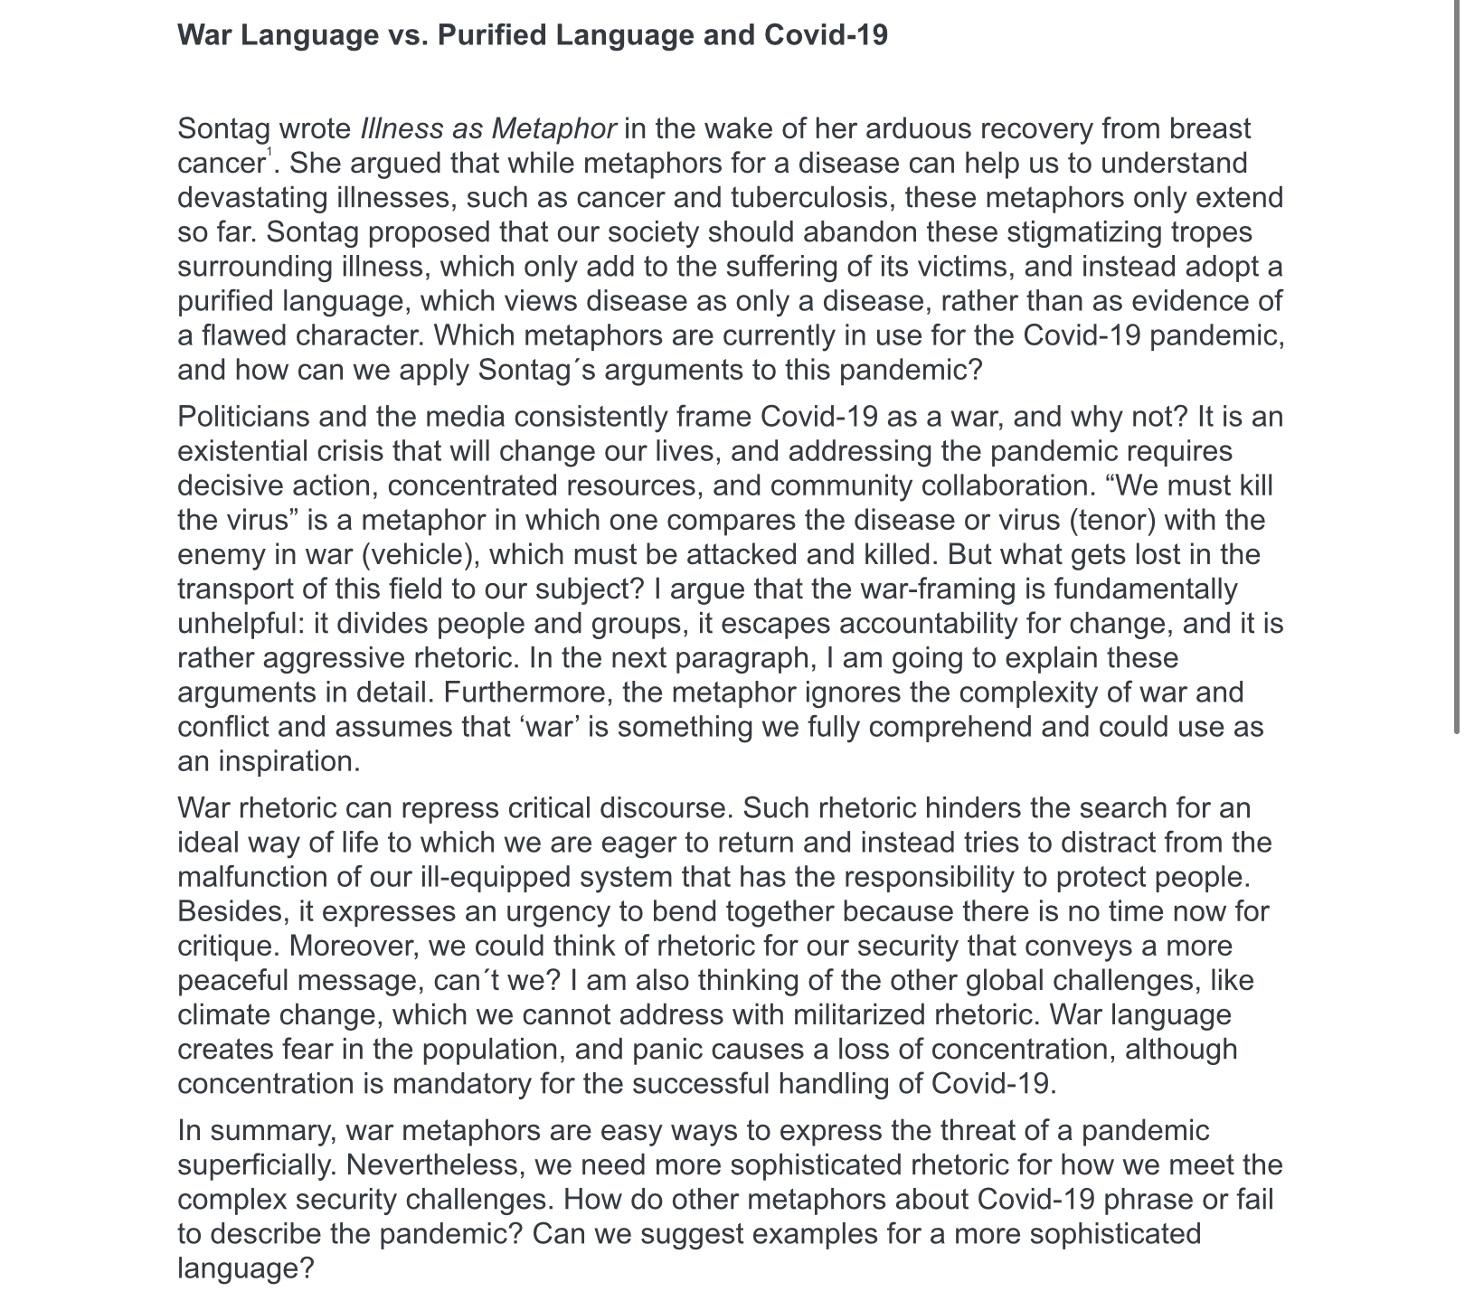
Blog Entries

Slide 15
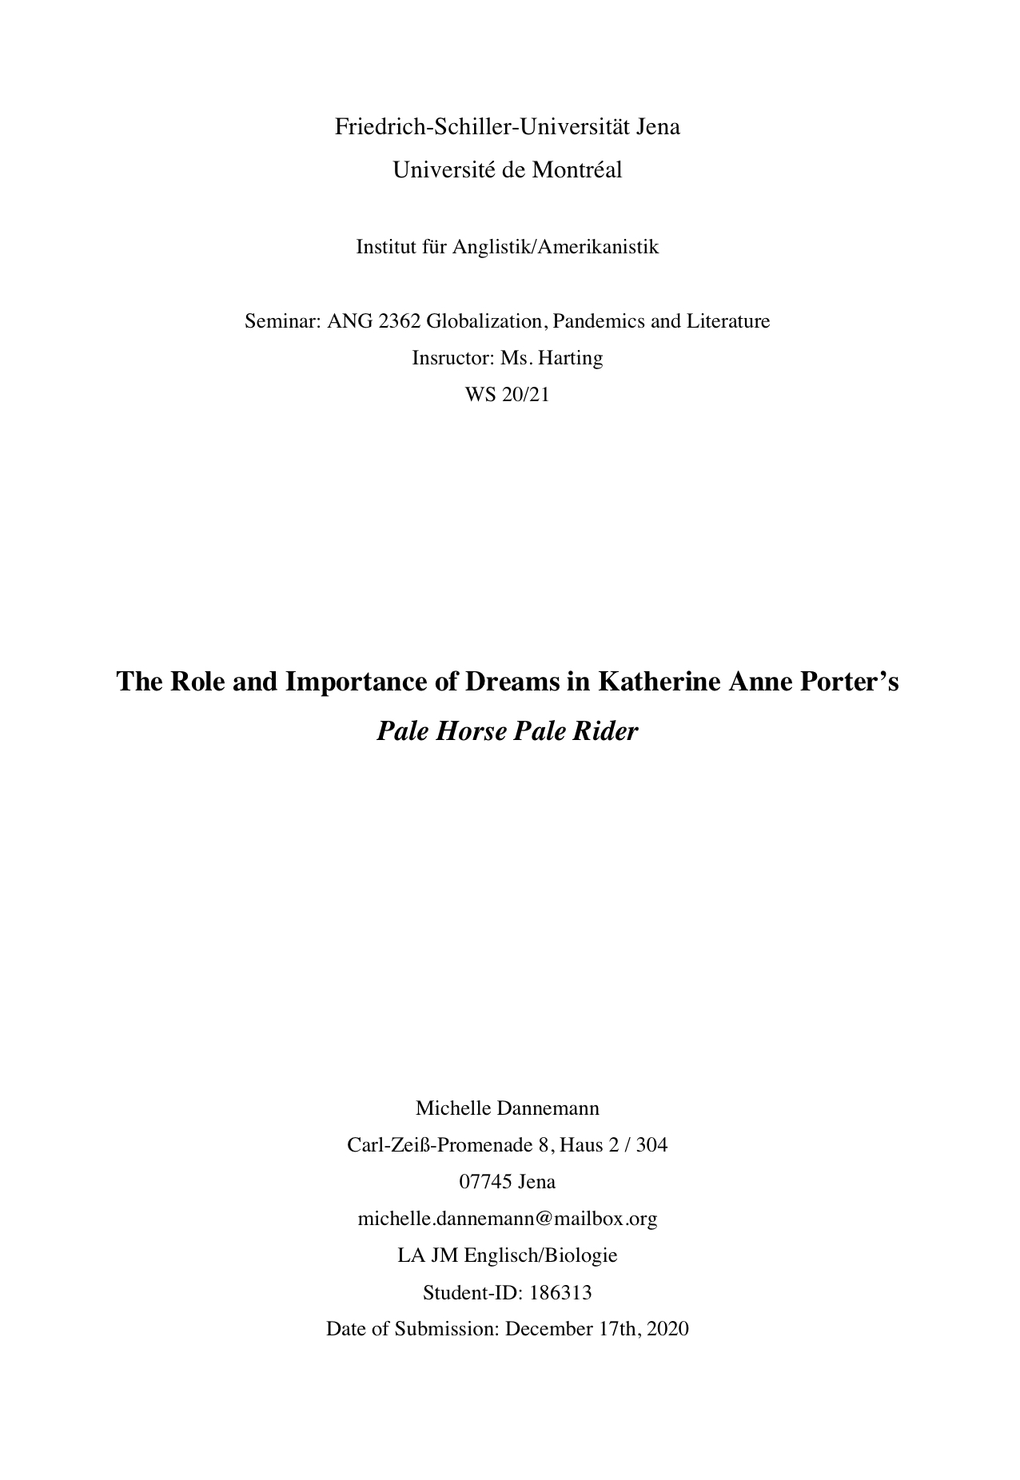
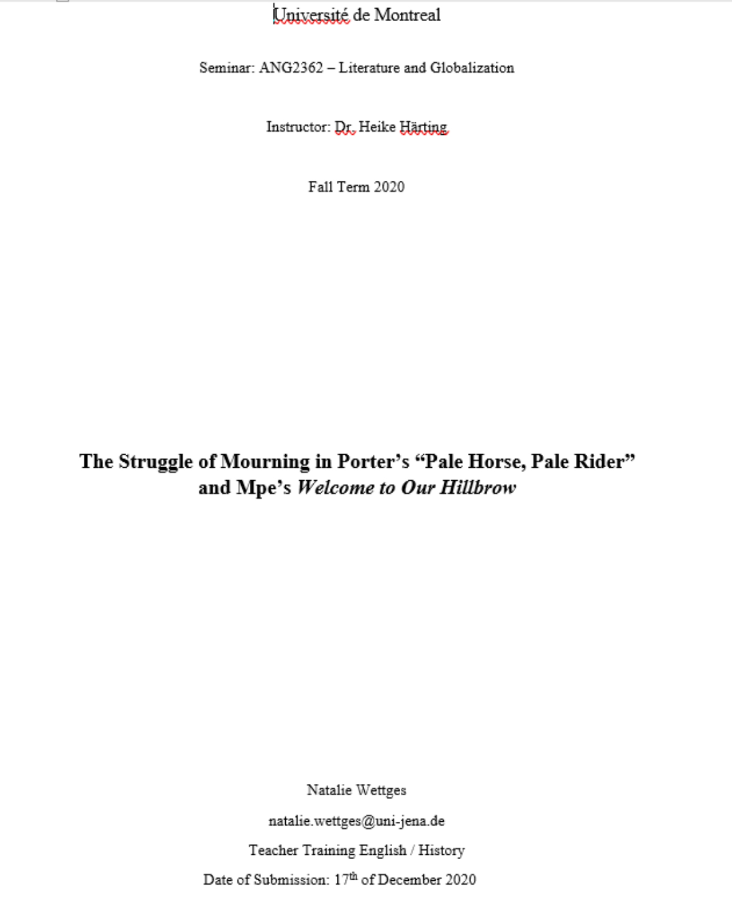
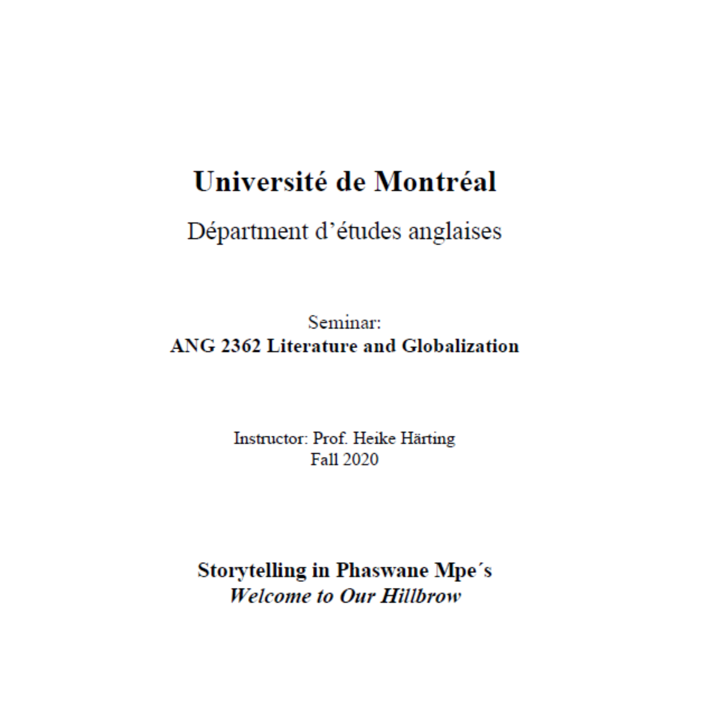
Research Essays

Slide 16
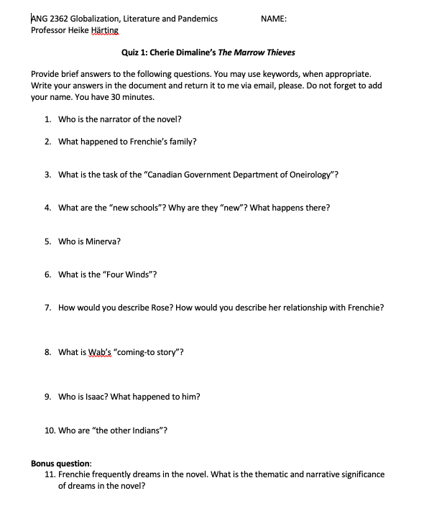
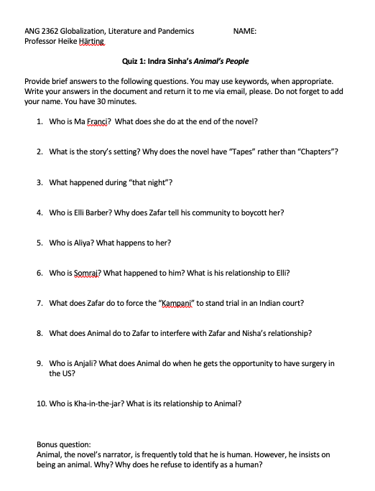
Written Tests

Slide 17
Comparison FSU
WP1 and WP2!!!
similarities:
work with zoom -> screen sharing, breakout rooms, partner work, discussions
differences:
guest lecturers -> read from one of the books we had to read
-> French language included in lectures
system of grading -> percentages and grading scales with letters
variety in exams -> digital commonplace book, blog entries, digital poster, blog entries, quizzes, essay
-> not dependent on one final exam

Slide 18
interesting variety of literature
-> new novel/text every week
-> access to library
broadened horizon towards:
cultural understanding
process of globalization
race and gender
Canadian history + writers
multilingualism
literary skills, text comprehension

Slide 19
friendly fellow students
-> possible connection in breakout sessions, StudiUM, university mail
competent, kind and helpful professor
motivation to improve English
authentic environment forced one to speak English
feedback from whole class -> further ideas and material
online class less expensive -> concentration limited due to online classroom setting

Slide 20


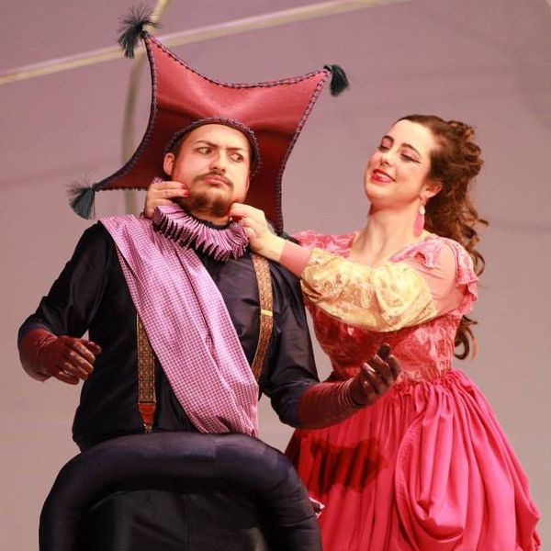

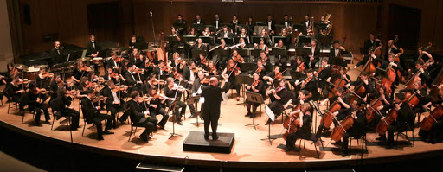
mail service kept us informed about Covid regulations
  -> Montréal as a red zone
  -> social life was restricted
  -> home office
under normal circumstances, UdeM provides variety of activities
-> sports clubs
-> exhibitions
-> drama clubs
-> music
-> …

Slide 21
Thank you for your attention!

Slide 22
Sources
https://admission.umontreal.ca/en/foreign-students/
https://www.macleans.ca/schools/universite-de-montreal/
https://armacad.info/2020-06-01--international-student-scholarship-2020-at-university-of-montreal-canada
https://www.uuchurch.org/2020/updates-to-zoom-meeting-links/
https://studium.umontreal.ca/
https://studium.umontreal.ca/my.policy
https://studium.umontreal.ca/course/view.php?id=182925
http://www.brunswick.k12.me.us/hdwyer/the-masque-of-the-red-death-by-edgar-allan-poe/
https://www.amazon.de/Marrow-Thieves-Cherie-Dimaline/dp/1770864865
https://www.amazon.de/Animals-People-Indra-Sinha/dp/1416526277
https://www.amazon.de/Gun-Island-Amitav-Ghosh/dp/1473686687
https://en.wikipedia.org/wiki/Welcome_to_Our_Hillbrow
https://www.goodreads.com/book/show/39070352-the-tiger-flu
https://admission.umontreal.ca/en/student-info/choose-udem/athletics-at-udem/
https://myscena.org/carol-xiong/higher-education-new-and-noteworthy/
https://www.umontreal.ca/etudes/
https://admission.umontreal.ca/en/focus-udem/article/10-things-that-will-make-you-wish-you-went-to-universite-de-montreal/

