Slide 1





Lab Buddy System
for Hybrid Practical Training and
the Integration of Online Students
into the Student Community
F. Sojka, J. Domke, C. Henkel, F. Lukas, J. Kretzschmar, R. Ackermann, C. Helgert, T. Pertsch
Abbe School of Photonics & Max Planck School of Photonics
Friedrich-Schiller-Universität Jena
Notes:
Hello and welcome to our presentation of the Lab Buddy System for Hybrid Practical Training and the Integration of Online Students into the Student Community. My name is Jari Domke and in the following we report the experiences we made during our work on the topic

Slide 2
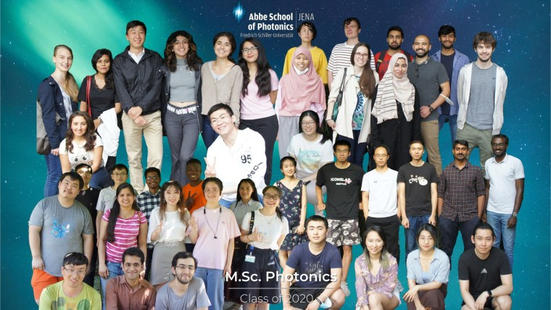
M.Sc. Photonics Program
An all-English, two-year Master’s Degree
Students with different backgrounds and nationalities
About 60-70 Freshmen every October
A limited number of slots in an adapted online course that allows to begin studies online
Majority of students are on-site but a significant number remain online
Notes:
The Master of Science in Photonics (M.Sc. Photonics) is an all-English, two-year Master's degree course providing multidisciplinary coverage in the field of optics and photonics offered by the Abbe School of Photonics (ASP) at the Friedrich-Schiller-University in Jena. The course schedule ranges from fundamental scientific subjects to application-oriented photonics engineering aspects. The program is designed to incorporate students of different backgrounds and nationalities and aims to provide them with a solid knowledge of optics and photonics, both for scientific research and for its technological applications in industry.
There are about 60-70 Freshmen every October with a limited number of slots in an adapted online course that allows to begin studies online. The majority of students is on-site but a significant number remains online in the beginning.

Slide 3
Master of Photonics Course Schedule
Preparation
1st Semester
2nd Semester
3rd Semester
Final Semester
  Kickstarter Course
  Pre-Course Math
  Lectures (Adjustment, Fundamentals)
  Experimental
  Lab Course
  Lectures
  (Fundamentals, Specialization)
  Internship
  Lectures (Specialization)
  Research Lab
  Master‘s Thesis
  Socializing and Community Building
  Organized by the Professors (usually via streaming)
  Organized by the Various Scientific Working Groups
  Focus of digiPhoton
Notes:
The course schedule consists of a number of different blocks with varying demand regarding the difficulty of transferring them to a purely digital environment. For example lecturers already take responsibility for their own lectures and routinely stream them using video services like Zoom or others.
Other courses like internships, research labs or Masters’s theses are offered and graded by the various scientific working groups present in Jena.
On the other hand there are courses that do not routinely take place digitally and demand our particular focus like the Experimental Lab Course at the end of the first semester.
Even earlier we offer students help and advice via our Kickstarter Course or our Math Pre-Course. A further and particularly challenging task is to encourage socializing and community building. This means effectively integrating the students into the student community, which requires opportunities and support especially for the online students. *
In the following though we will focus on our Experimental Lab Course and the way we tried to make it accessible for online students.

Slide 4
Labcourse - State before the Digitalization
Goals of the course
Experimental experience
Team work experience
Learn to write a scientific report
General information about the course
8 experiments are scheduled
Group of two students (randomly assigned)
After collecting experience and data
  Elaboration of a joint report
Grades are given for the experimental part (preliminary talk, lab) and the report
Schedule of the block course
1st day: homework (lab preparation) Investigate the manual and basics
2nd day: experiment
One experiment per day, 4h timeslot
3rd day: homework (lab report)
R
E
P
E
A
T
Notes:
We first looked at how the course was managed in its previous offline form.
The Lab Course was designed with three main goals in mind that we aimed to retain through the digitalization process. After finishing the lab course, students were supposed to have gained some experimental experience as well as team work experience. They also should be able to write a scientific report on the subject. *
The entire class is scheduled as a block course at the end of the semester. An experiment took place in the course of 3 days: the first day for preparation, the second day for experimentation within a 4 hour timeslot and the third day for writing the report. Overall eight reports had to be submitted by each student.*
To lessen the workload on the students, they were randomly assigned to a partner. These groups of two then handed in a joint report on the experiment. After that both the performance in the laboratory as well as the reports submitted were graded by a supervisor.

Slide 5
Labcourse - State after the Digitalization
Goals of the course
Experimental experience
Team work experience
Learn to write a scientific report
General information about the course
8 experiments are scheduled
Group of two students (randomly put together)
After collecting experience and data
  Elaboration of a joint report
Grades are given for the experimental part (preliminary talk, lab) and the report
and one online student
Schedule of the block course
1st day: homework (lab preparation) Investigate the manual and basics
2nd day: experiment
One experiment per day, 4h timeslot
3rd day: homework (lab report)
using tools like Gather.town, ZOOM, Discord
R
E
P
E
A
T
provided via Moodle
submission via Moodle
Notes:
Some aspects of this lab course could easily be digitalized. As a matter of fact, the entire course is managed digitally via Moodle. For collaboratively writing reports students can use tools provided by the Abbe School of Photonics like Gather.town, Zoom or Discord. * In this presentation though we want to focus on the most challenging part of hybrid experimentation.

Slide 6
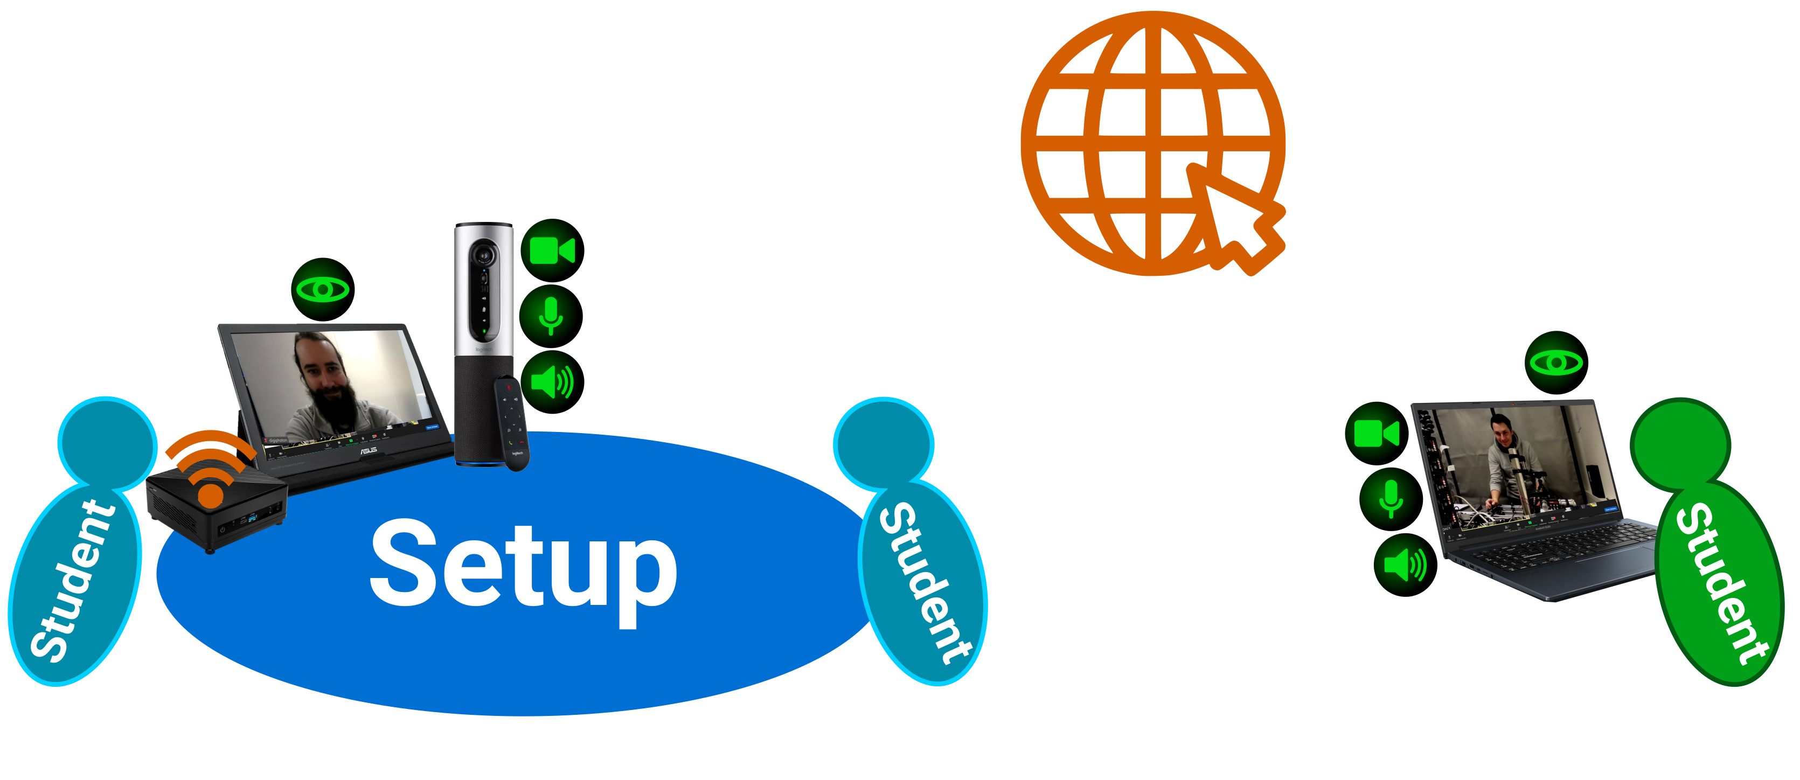
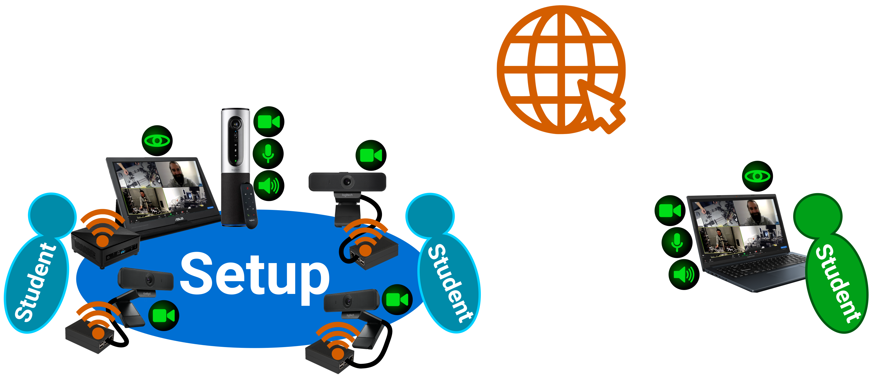
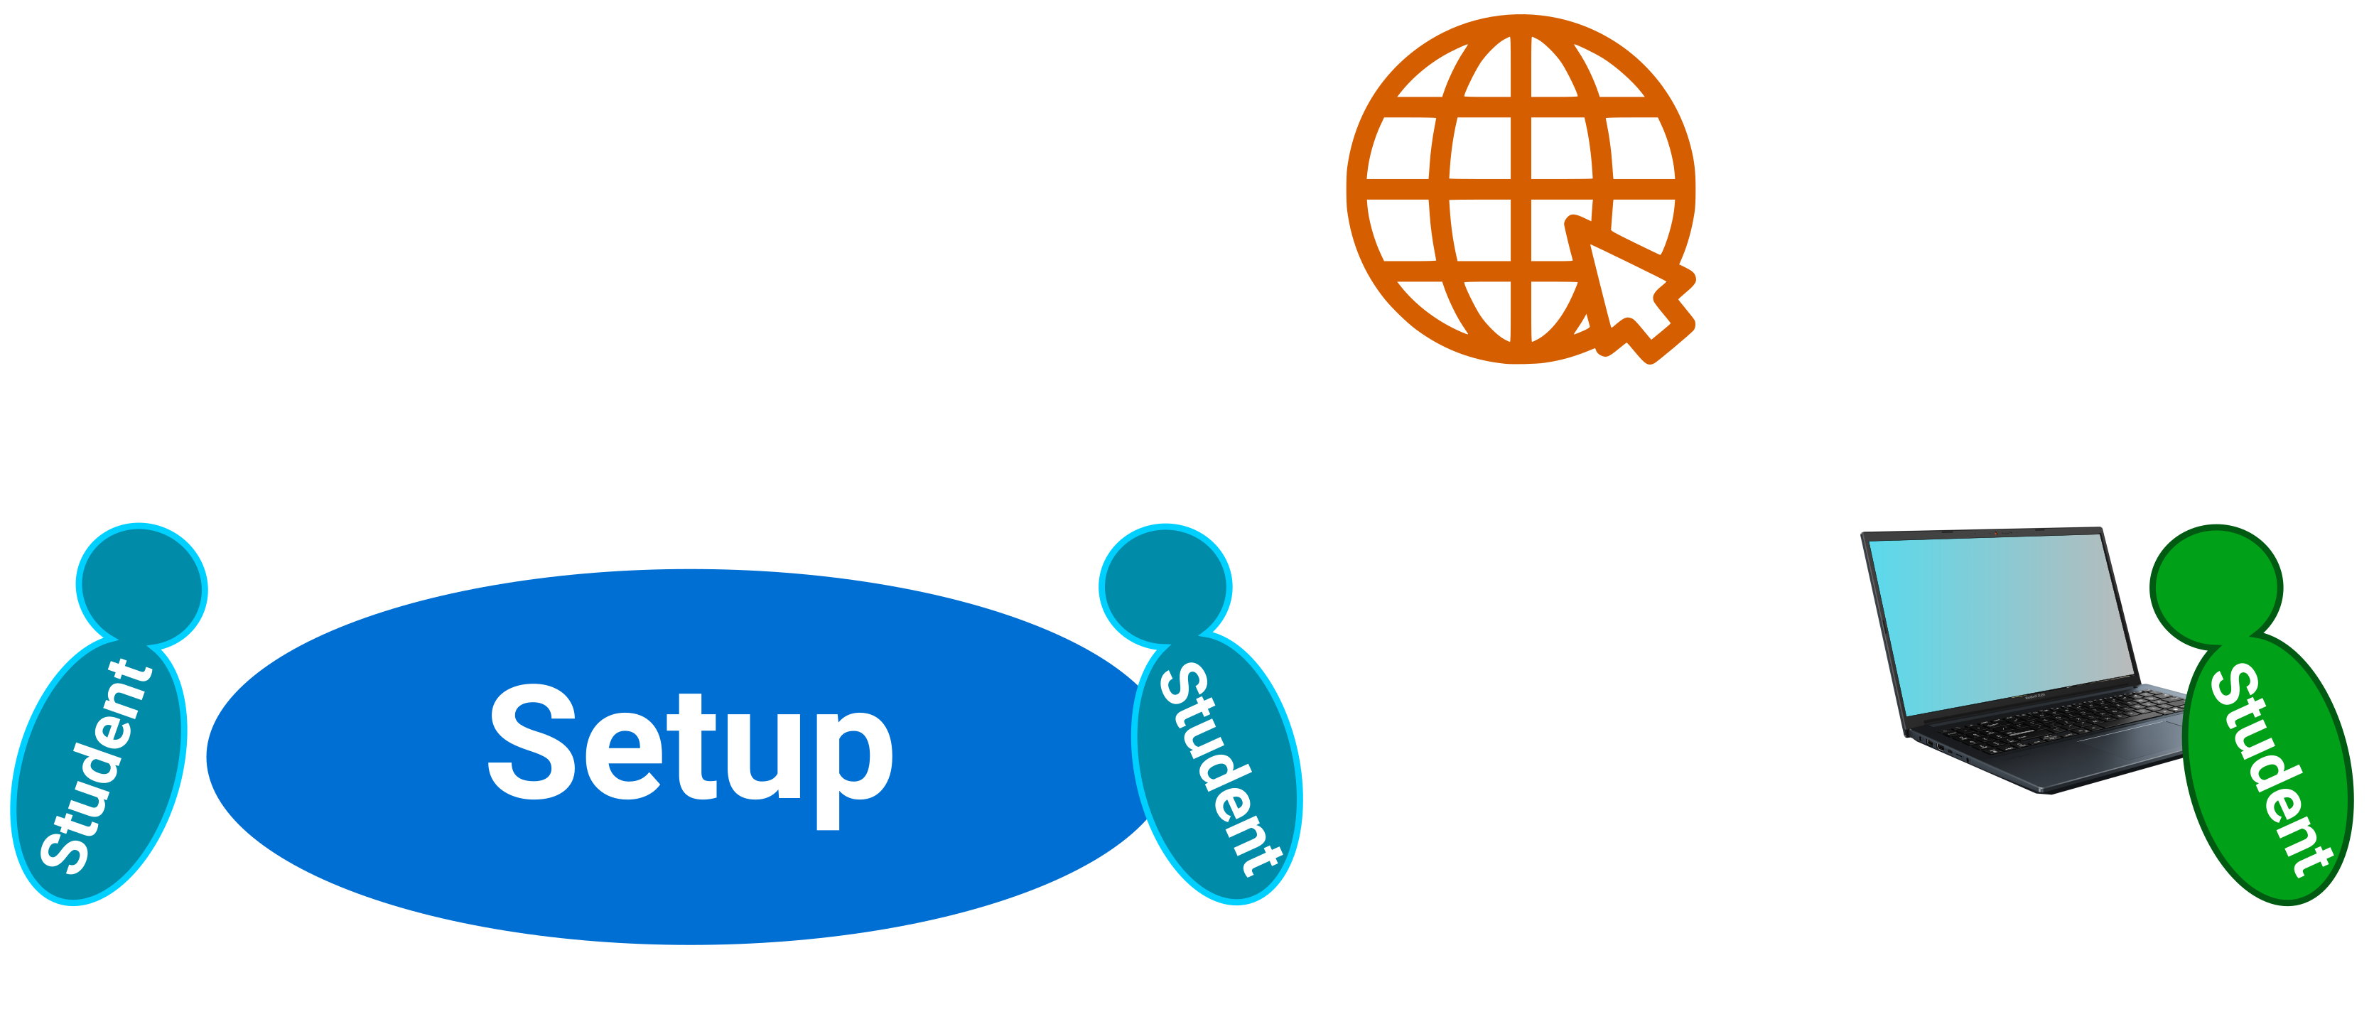
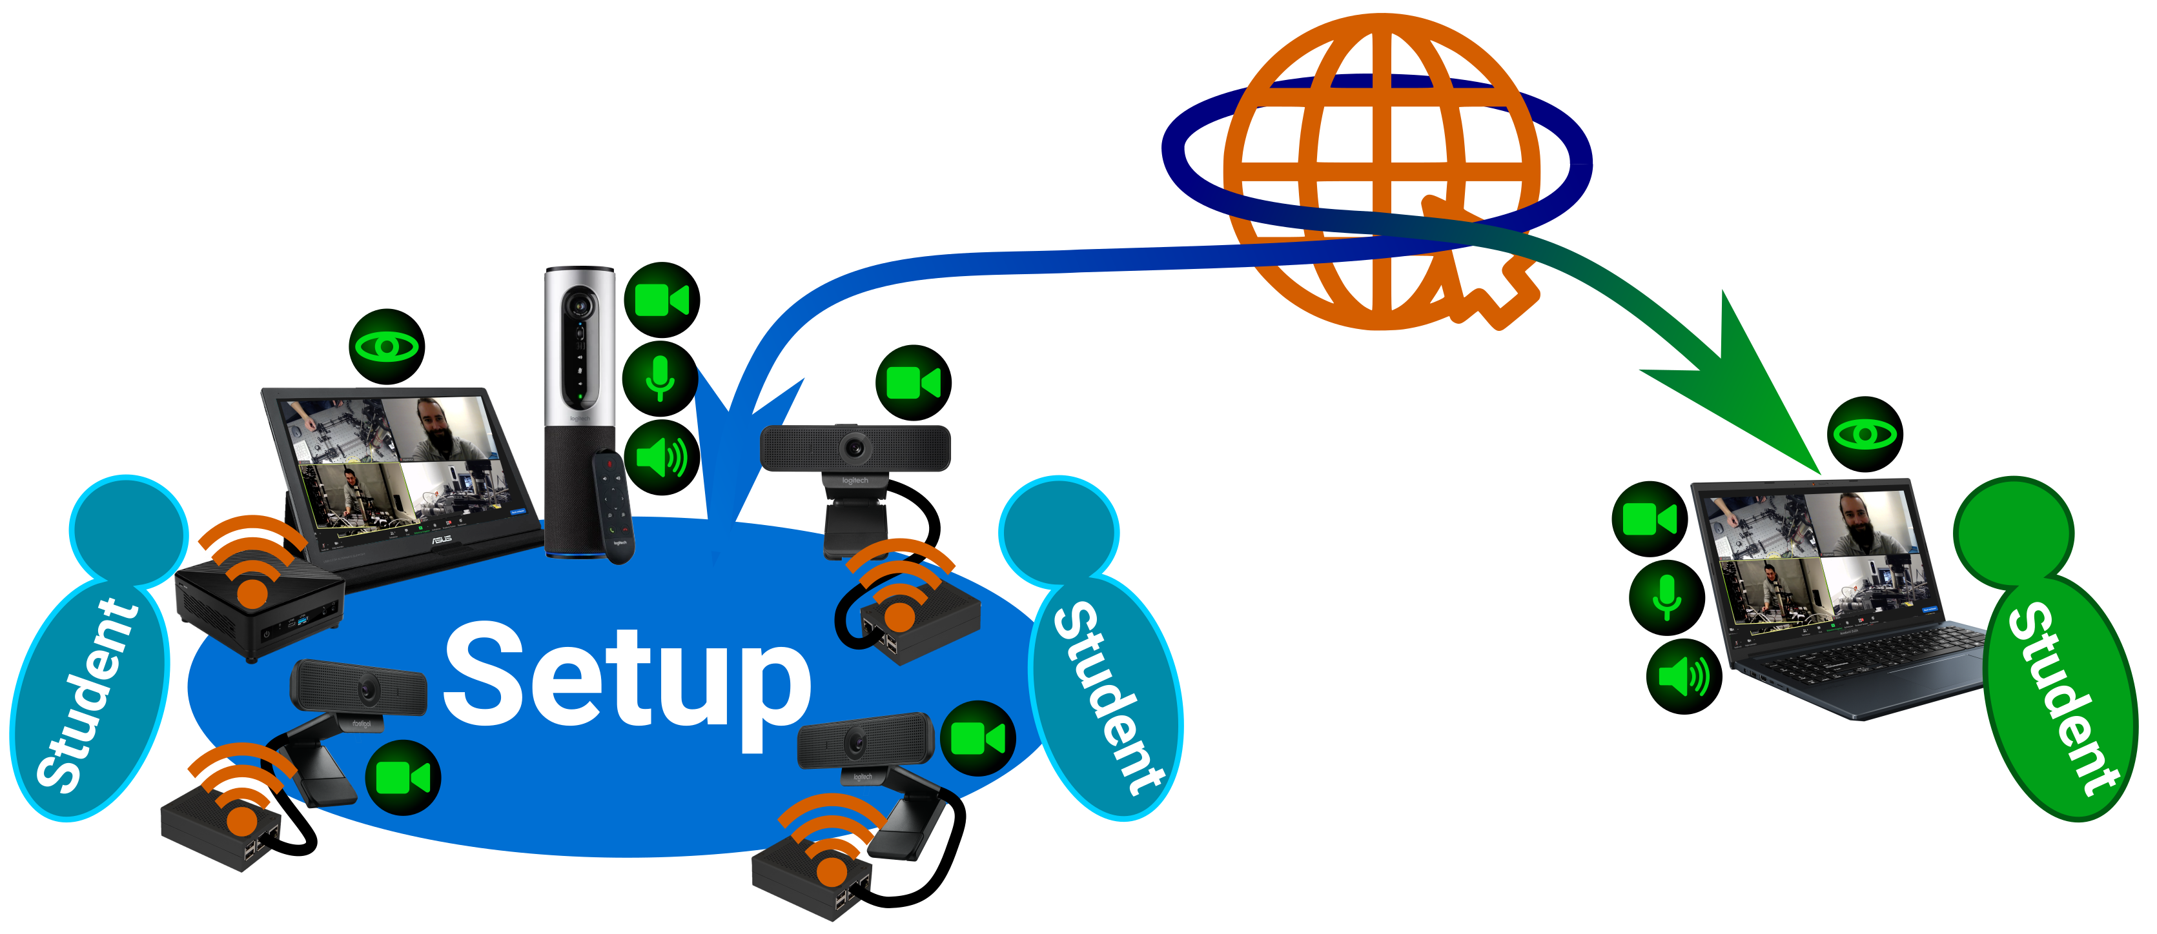
Lab Buddy System - Overview
Two on-site students, one online student
Regular video conference
Multiple cameras via single-board computers
Hands-free audio
Notes:
Our solution to this problem is the Lab Buddy System, which we already tested in the winter semester of 2021 and 2022.*
It is a multi-camera conference system that enables a team consisting of two on-site students and one online student to work together in the lab.*
The system essentially consists of a video conference meeting equipped with a large number of cameras – in our case PiCams -- which provide various perspectives on the experimental setup. * There is also a hands-free device that enables audio interaction regardless of the number of people present.

Slide 7
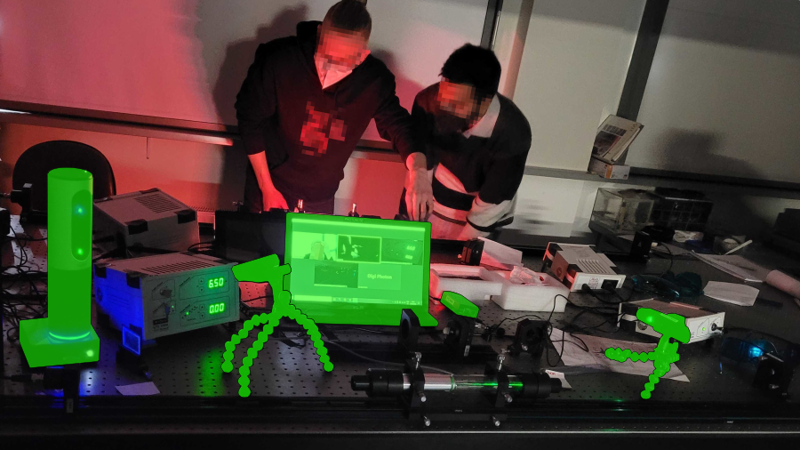
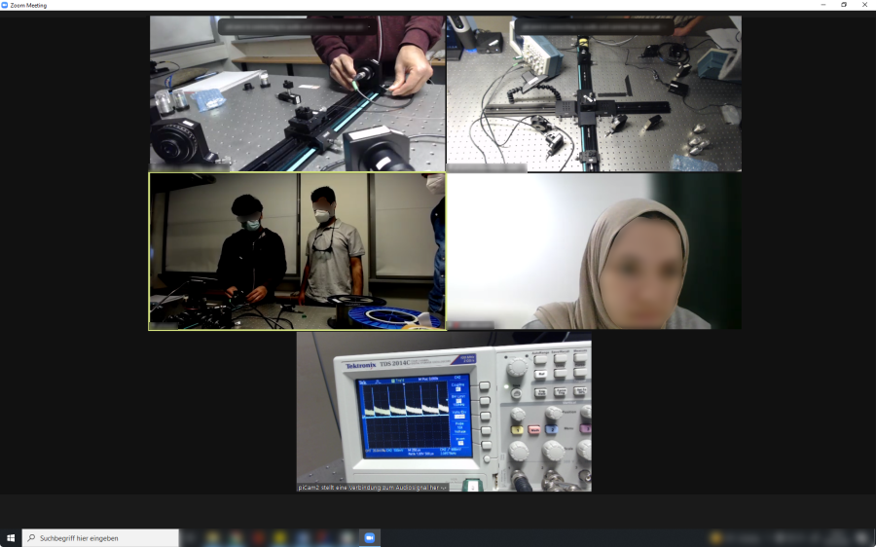
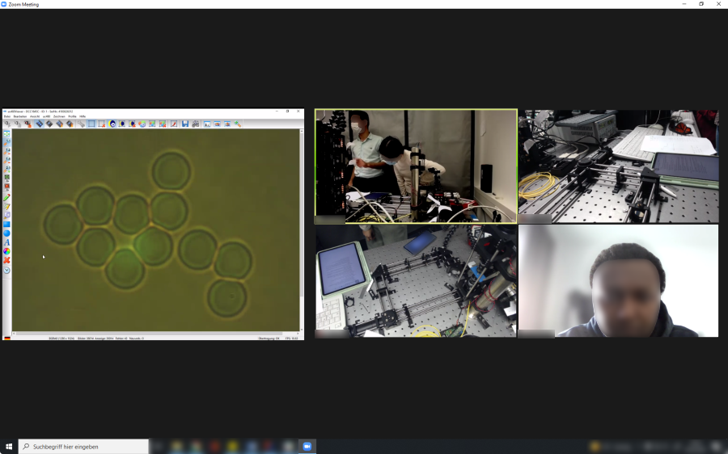
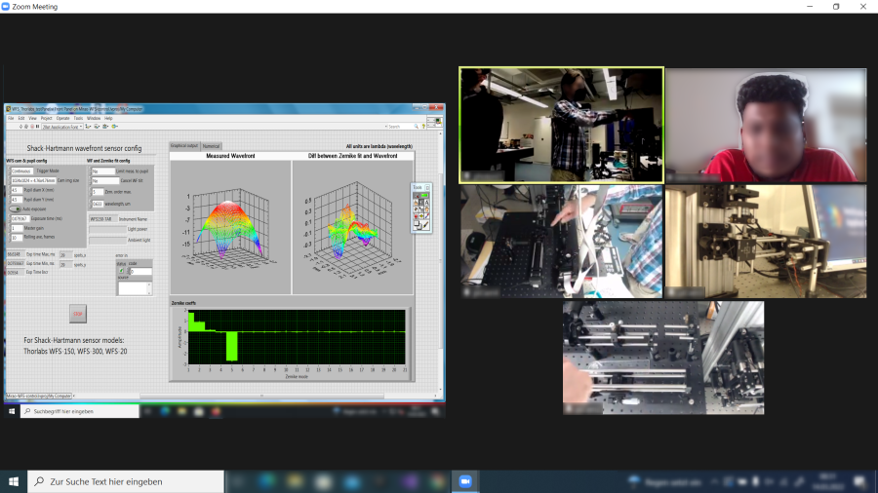
Lab Buddy System - Advantages
Easy installation
  single-board computers auto-connect
  themselves to the meeting
Easy management
  different groups in different breakout rooms
Easy to use
  independent of the number of participants
  moveable webcams on flexible tripods
Notes:
The general focus of our Lab Buddy System was the ease of use and setup. Several groups can be managed via a breakout room function using Zoom, the number of participants both onsite and online is flexible and the cameras can be adjusted even while the experiment is ongoing.

Slide 8
Lab Buddy System - Qualitative Evaluation
Most Important Question: What needs to be improved or should be done differently?
“The sound system. And the background noisy sound.”
“Better noise cancellation, but not sure what to suggest here that is reasonable.”
“This was my first time collaborating with an online student like this so if you were to keep this format you could maybe advise the on site students to explain tasks more frequently and try actively engaging.”
“It's hard to say. I don't think much more can be done to include online students.”
“As an idea, online students can be given AR access to the lab or a controllable VR environment (eg. via Metaverse) with special AR cameras for a more immersive experience. It seems farfetched but if distance learning is to be integrated permanently, this should be looked into.”
“Your job was perfect. Maybe a cup of coffee or a coffee maker in the lab! ;)”
Notes:
“What needs to be improved or should be done differently?”
It was answered in the following ways:
From this survey as well as our experience and observations during the lab course we concluded that a few issues still needed to be addressed.

Slide 9
Lab Buddy System
What have we learned and what do we do next?
The sound quality should always be kept in mind.
  We switched from headsets to conferencing systems.
  The online students should also be supported in advance to be able to use a good headset.
Students should be prepared for this type of interaction in advance.
  Rules of conduct for both sides should be defined and discussed beforehand.
  Behavioral advice for specific situations should also be provided.
Active matchmaking by most likely subjective criteria which have yet to be found.
  Perhaps the pairs should be asked if they would like to have an online student on the team, as another group member is also a great opportunity.
Installation of interactive elements for the online students.
  Remote controllable measurement software
  Remote controllable experimental hardware
Notes:
Thus, the question that we have to answer is: “what have we learned and what should be improved in the future?” *
Number one is the sound quality. This can be especially challenging in a laboratory environment with lots of active equipment, we switched from wireless headsets to a speaker type conference system which seems to be better suited for the job. Furthermore the online students should be made aware of the issue as well and have access to devices featuring a decent audio quality.*
Additionally, students should be prepared for this unusual type of interaction in advance. Rules of conduct should be determined and discussed beforehand and advice for specific challenging situations should be provided to avoid demotivation. * To aid this we are also considering active matchmaking to promote beneficial group constellations, which also includes considering the students opinions as having an online partner does not only include additional difficulties but can also be a great opportunity. *
Last but not least we strive to provide the online students with opportunities to take on a more active role by providing hardware and software that can be remotely controlled by them.

Slide 10
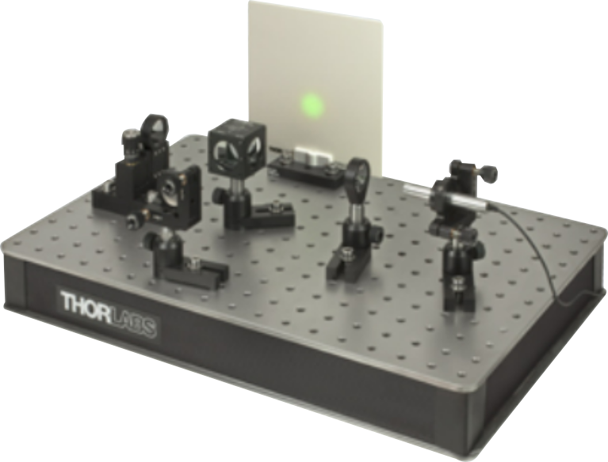
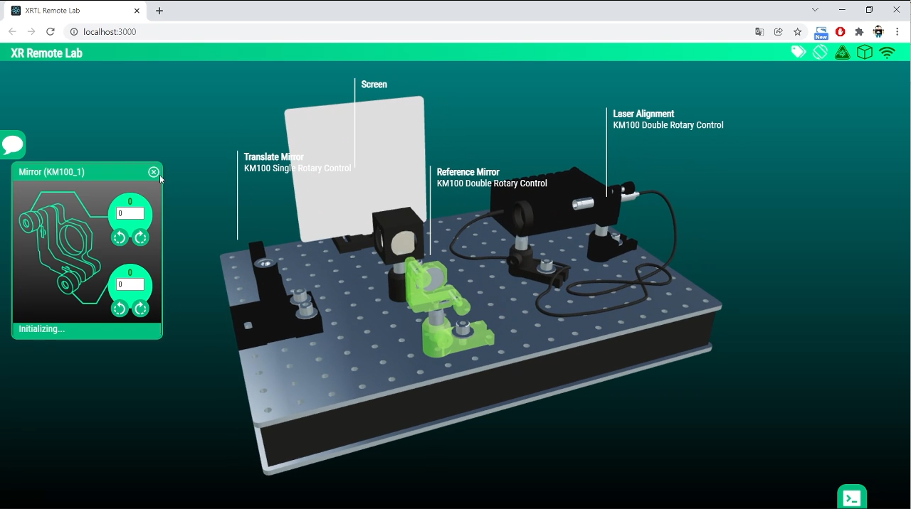
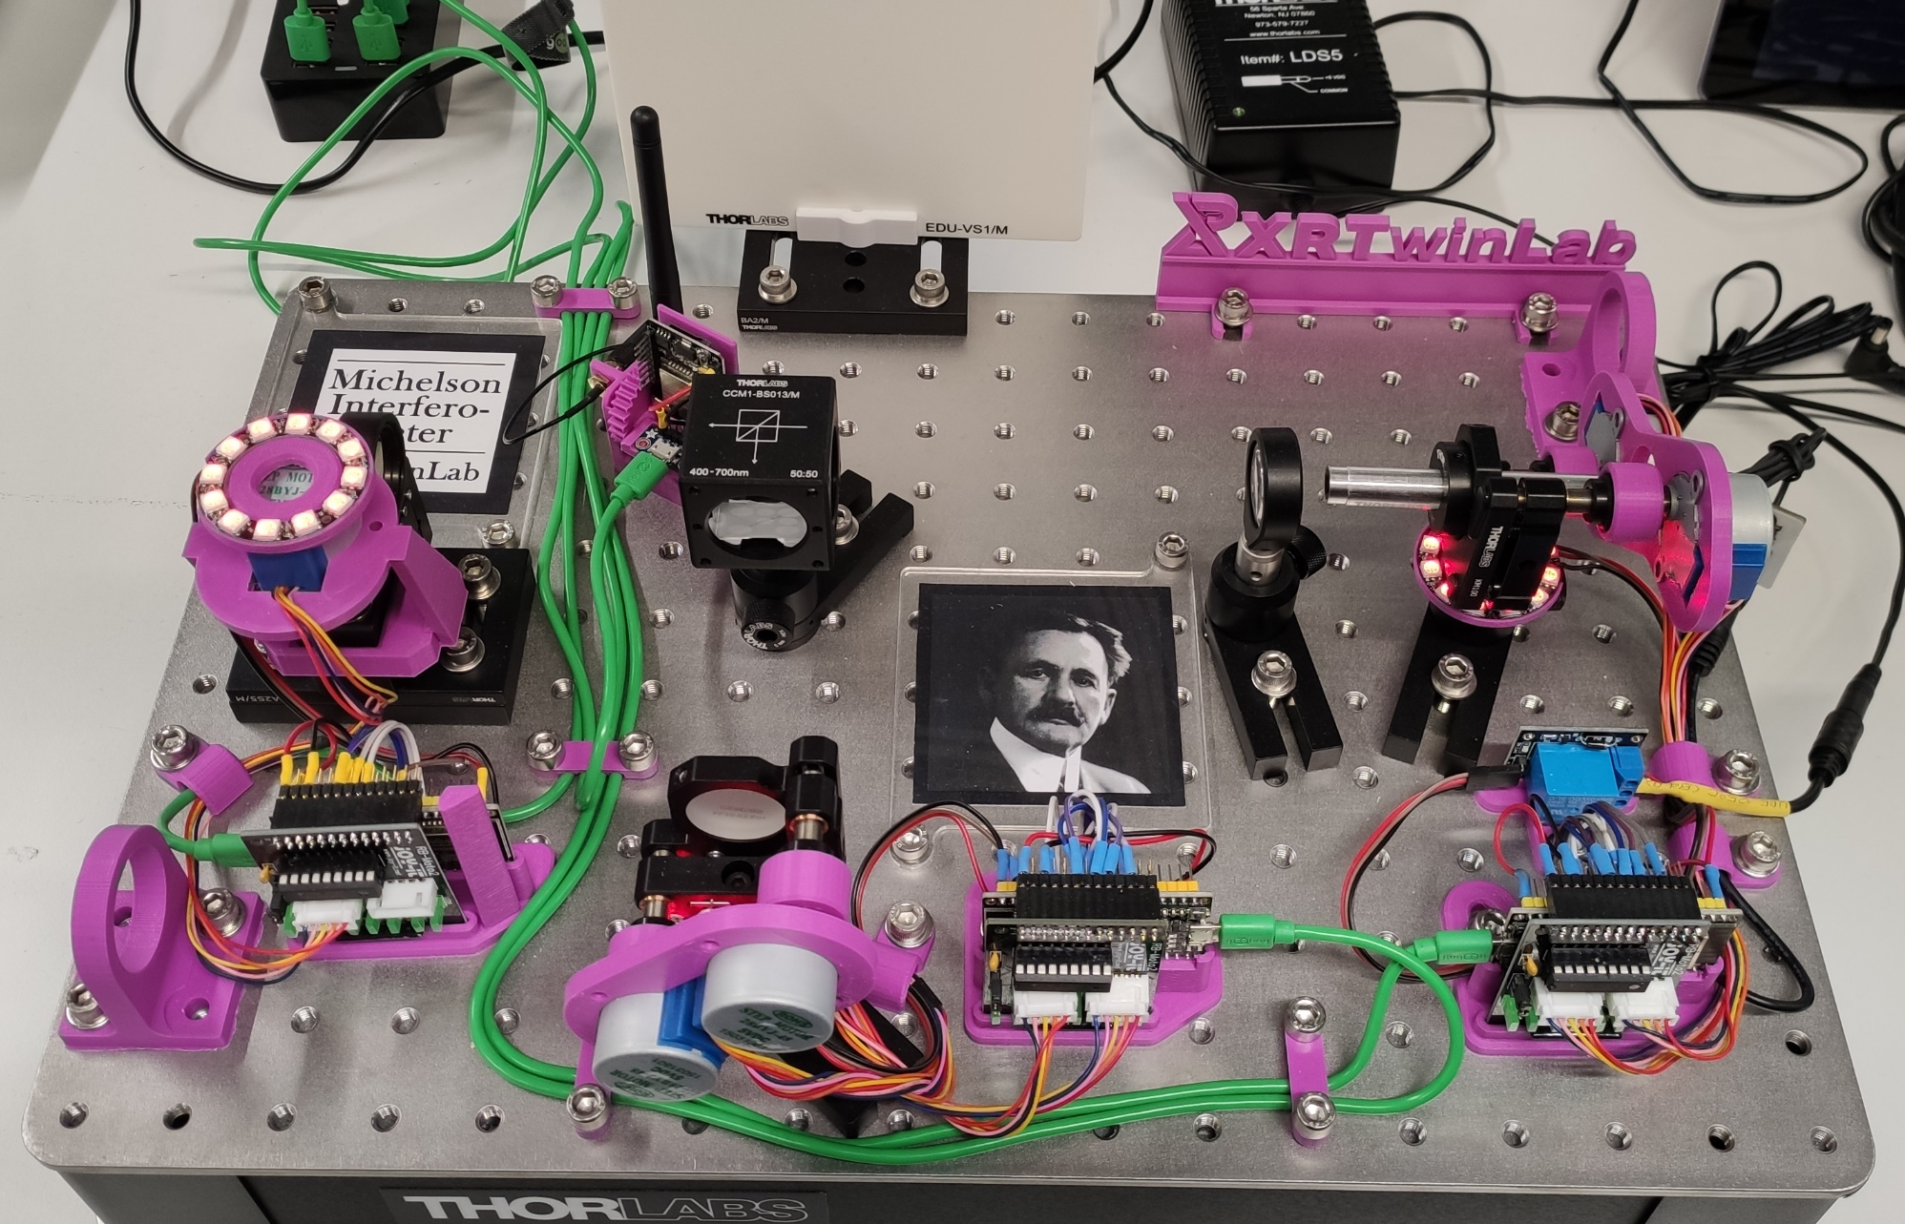
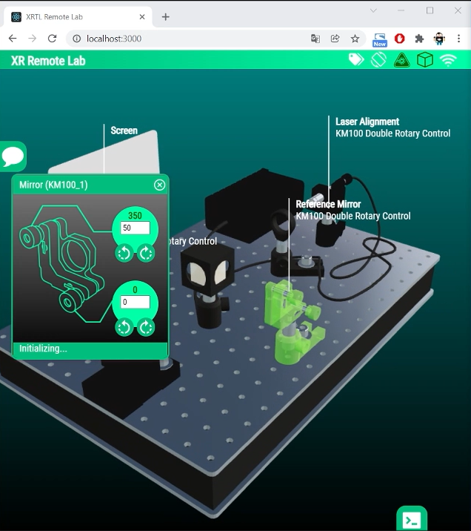
XR Twin Lab
Platform-independent, modularly
expandable React.js application
with OpenGL rendering
Thorlabs Educational Kit Michelson Interferometer with
3D printed attachments, actuators, camera, microcontrollers
J. Kretzschmar, C. Henkel, F. Sojka, J. Domke, T.Kaiser, C. Helgert, T.Pertsch, “XR Twin Lab: an Open Source Toolbox for XR Remote Access of Experimental Setups in Photonics based on Web Technologies” Proceedings of DigiLab4U : Online-labs in education, 2022, Stuttgart, Germany
Notes:
Considering the impact of the remotely controlable hard- and software we started to work on that immediately. We now have a working prototype of an experiment that can be controlled remotely, yet offers most the possibilities to manipulate the experiment that are available to an on-site student.
Using a platform-independent, modularly expandable React.js application with OpenGL rendering we are planning to make our experiments accessible for anyone, anywhere – provided an adequate internet connection is available. For us the most important feature is that experiments are done for real and not using a simulation. Noise and other maybe more subtle physical effects not neccessarily included in a simulation can be observed. More importantly, students can observe the real experiment and export relevant data on their own.

Slide 11
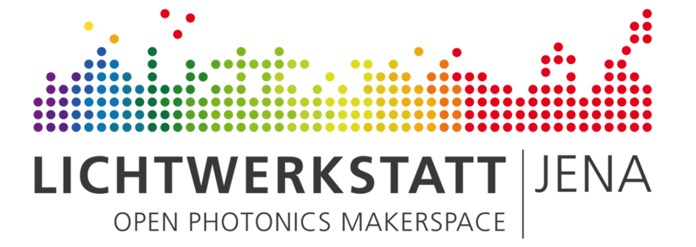

Curriculum
(Master of Photonics)
Science Communication
Scientific Operation
Ideas, Tasks,
Challenges
Maker
Community
Apps,
Formats,
Content
Hackathons
Hardware
Impulses, Best-Practices,
Open Source Technologies and Projects
Mentoring
Students
J. Kretzschmar, S. Best, D. Zakoth, H. Voigt, K. Li, T. Kaiser, R. Geiss, C. Helgert, and T. Pertsch, "Utilizing Open Spaces for community-driven Development of XR Teaching Applications in Photonics," in Education and Training in Optics and Photonics Conference 2021,
A. Danner, A. Poulin-Girard, and N. Wong, eds., OSA Technical Digest (Optical Society of America, 2021), paper F1B.7
Notes:
The Lab Buddy System, the XR Twin Lab as well as many other projects have been realized with our partners from the Open Photonics Makerspace Lichtwerkstatt Jena.

Slide 12
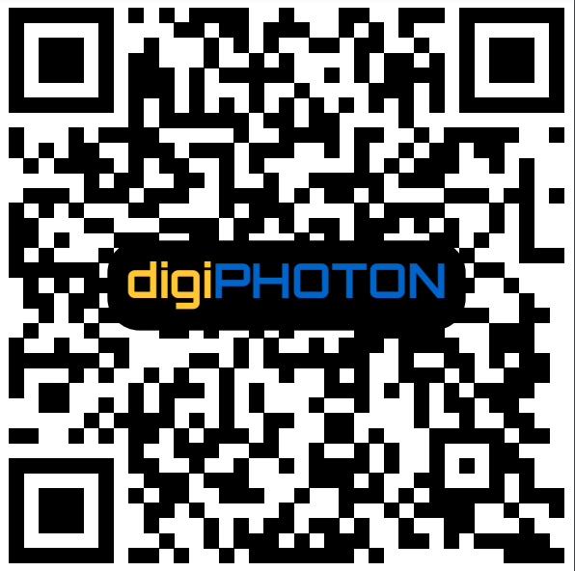
Thanks
Questions, Suggestions
(Scan code or open link in image)
Notes:
Thank you for your attention. If you have questions or suggestions regarding the topic presented, feel free to write us an email to the address provided by the QR-code or by using the link embedded in the image.

